Slide 1
A Case Study of Traffic Locality in Internet P2P Live Streaming Systems
Yao Liu @ George Mason University
Lei Guo @ Yahoo! Inc.
Fei Li @ George Mason University
Songqing Chen @ George Mason University

Slide 2
Background
Internet P2P applications are very popular
P2P traffic has accounted for over 65% of the
Internet Traffic.
Participating peers not only download, but also contribute their upload bandwidth.
Scalable and cost-effective to be deployed for content owners and distributors.
Specifically, file sharing and streaming contribute the most P2P traffic.

Slide 3
Overlay vs. Underlay
Network-oblivious peering strategy
BLIND overlay connection
Does not consider the underlying network topology
Increases cross-ISP traffic
Wastes a significant amount of Internet bandwidth
50%-90% of existing local pieces in active users are downloaded externally
Karagiannis et al. on BitTorrent, a university network (IMC 2005)
Degrades user perceived performance

Slide 4
Related Work
Biased neighbor selection
Bindal et al. (ICDCS 2006)
P4P: ISP-application interfaces
Xie et al. (SIGCOMM 2008)
Ono: leverage existing CDN to estimate distance
Choffnes et al. (SIGCOMM 2008)
Require either ISP or CDN support
Aim at P2P file-sharing systems
How about Internet P2P Streaming systems?
Play-while-downloading instead of open-after-downloading
Stable bandwidth requirement

Slide 5
Our Contributions
Examine the traffic locality in a practical P2P streaming system.
We found traffic locality is HIGH in current PPLive system.
Such high traffic locality is NOT due to CDN or ISP support.

Slide 6
Outline
Overview
Returned peer IP addresses
Traffic Locality
Response time
Traffic contribution distribution
Round-trip Time

Slide 7
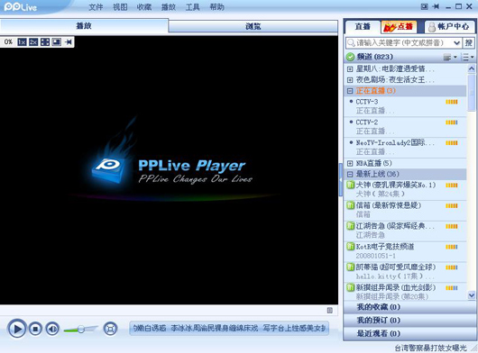
Overview of PPLive
PPLive is a free P2P based IPTV application.
First released in December 2004.
One of the largest P2P streaming network in the world.
Live Streaming
150 channels
VoD Streaming
Thousands

Slide 8
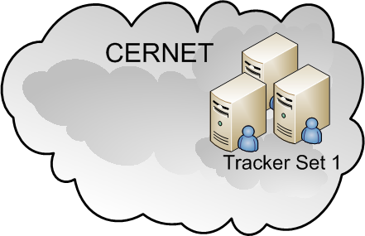
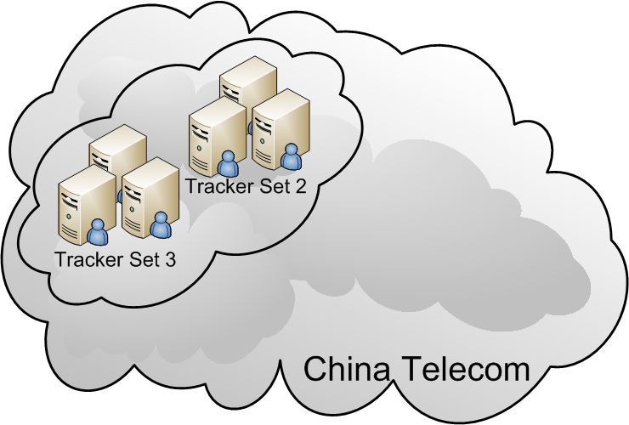
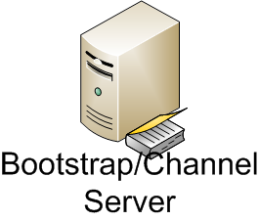
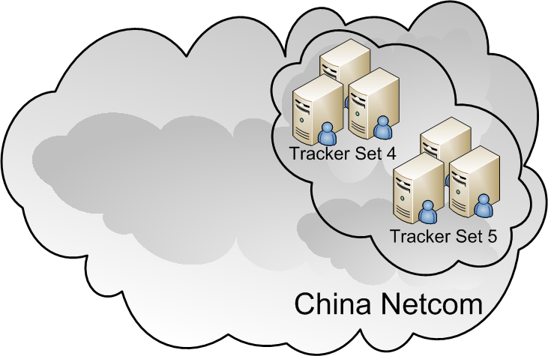
Overview of PPLive
(6)
(5)
(1)
(5)
(3)
(6)
(2)
(4)
(5)
(6)

Slide 9
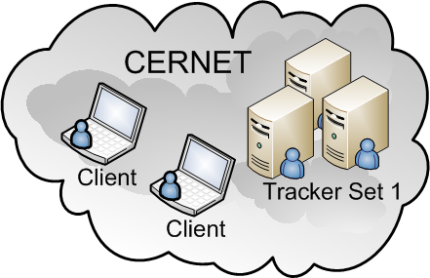
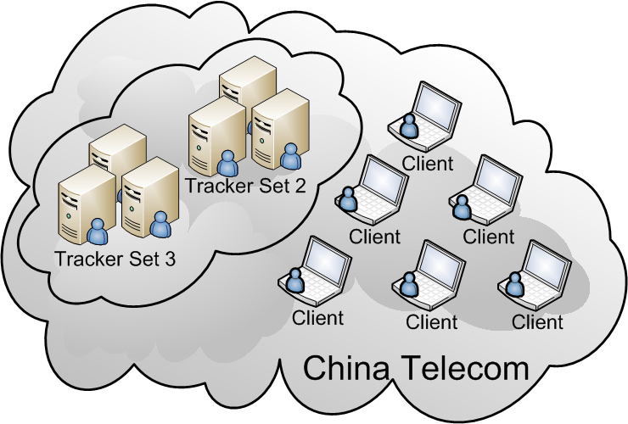
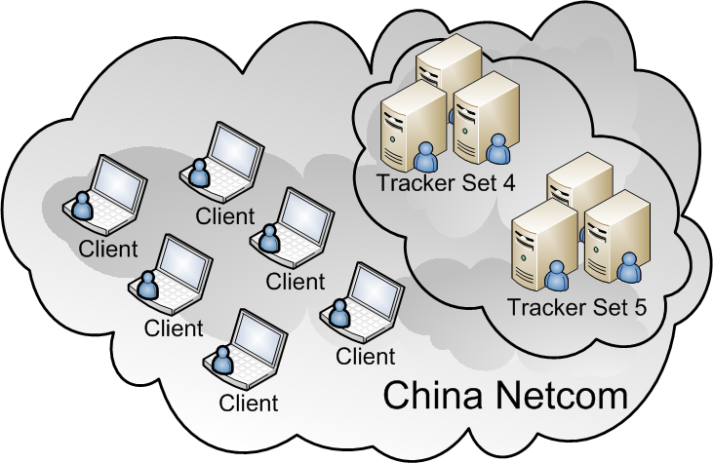
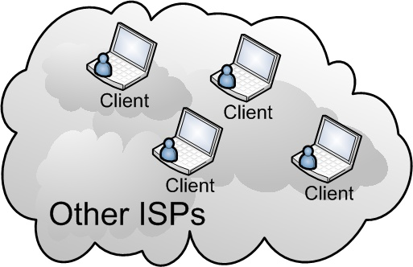
Overview of PPLive
(6)
(5)
(1)
(5)
(3)
(6)
Peerlist Request
Data Request
(2)
(4)
(5)
(6)

Slide 10
Methodology
PPLive 1.9
Four Weeks
Oct 11th 2008 – Nov 7th 2008
Collect all in-out traffic at deployed clients
Residential users in China
China Telecom
China Netcom
China Unicom
China Railway Network
University campus users in China
CERNET
USA-Mason
TELE
CNC
OtherCN
CER

Slide 11
Methodology (Cont’)
Watch popular and unpopular channels at the same time
Analyze packet exchanges among peers
Returned peer lists
Actually connected peers
Traffic volume transferred

Slide 12
Outline
Overview
Returned peer IP addresses
Traffic Locality
Response time
Traffic contribution distribution
Round-trip Time

Slide 13
Returned peers (with duplicate)
China-TELE watching Popular
China-TELE watching unpopular
# of returned addresses
# of returned addresses

Slide 14
Returned peers (with duplicate) cont.
China-TELE watching Popular
China-TELE watching unpopular
TELE
# of returned addresses
# of returned addresses
CNC
CNC_p
TELE_p
CER_p
OTHER_p
CNC_p
TELE_p
CNC_s
TELE_s
CER_s

Slide 15
Outline
Overview
Returned peer IP addresses
Traffic Locality
Response time
Traffic contribution distribution
Round-trip Time

Slide 16
Traffic Locality
China-TELE watching Popular
China-TELE watching unpopular
# of data transmissions
TELE
CNC
TELE
CNC
# of bytes
TELE
CNC
TELE
CNC

Slide 17
Four-week results
Popular Channel
Unpopular Channel
80%
90%
Traffic Locality (%)
60%
40%

Slide 18
Summary (1)
PPLive achieves strong ISP-level traffic locality, especially for popular channels.

Slide 19
How such high traffic locality is achieved?

Slide 20
Outline
Overview
Returned peer IP addresses
Traffic Locality
Response time
Traffic contribution distribution
Round-trip Time

Slide 21
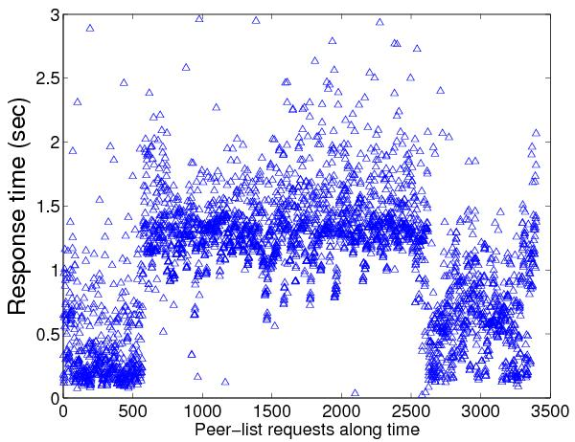
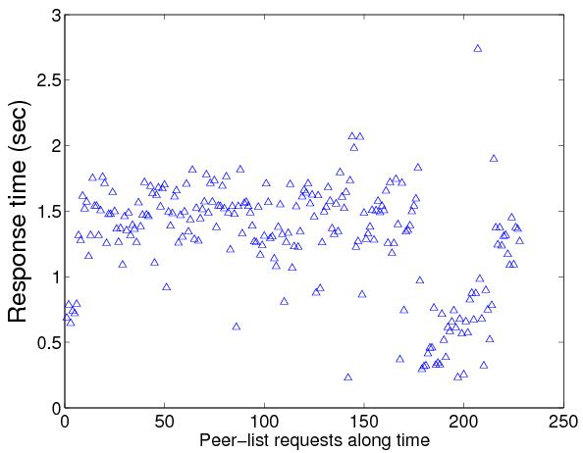
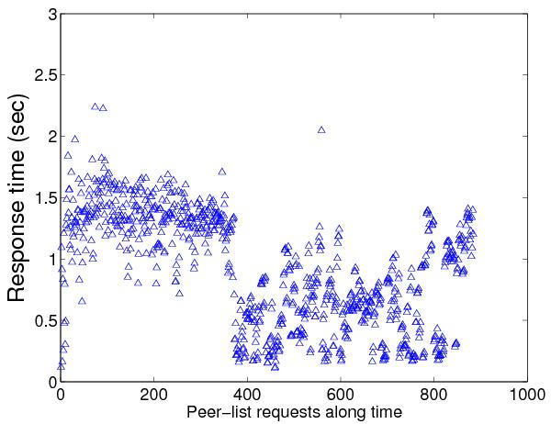
Peer-list Request response time
China-TELE peer watching popular channel
Response Time (sec)
3500
250
1000
TELE peers: 1.1482s
CNC peers: 1.5640s
OTHER peers: 0.9892s
(CERNET, OtherCN, Foreign)
First 500 requests to
TELE peers

Slide 22
Peer-list Request response time
 | TELE-Unpopular | Mason-Popular | Mason-Unpopular
TELE Peers | 0.7168 | 0.3429 | 0.5057
CNC Peers | 0.8466 | 0.3733 | 0.6347
OTHER Peers | 0.9077 | 0.2506 | 0.4690

Slide 23
Data Request response time
 | TELE-Popular | TELE-Unpopular
TELE Peers | 0.7889 | 0.5165
CNC Peers | 1.3155 | 0.6911
OTHER Peers | 0.7052 | 0.6610
 | Mason-Popular | Mason-Unpopular
TELE Peers | 0.1920 | 0.5805
CNC Peers | 0.1681 | 0.3589
OTHER Peers | 0.1890 | 0.1913

Slide 24
Summary (2)
PPLive achieves strong ISP-level traffic locality, especially for popular channels.
Peers in the same ISP tend to respond faster, causing high ISP-level traffic locality.

Slide 25
Outline
Overview
Returned peer IP addresses
Traffic Locality
Response time
Traffic contribution distribution
Round-trip Time

Slide 26
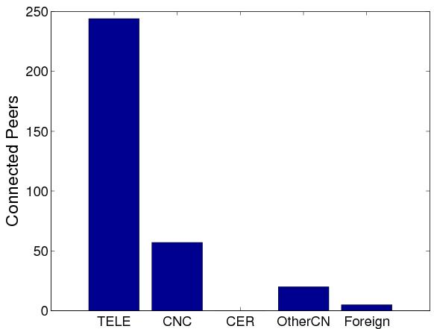
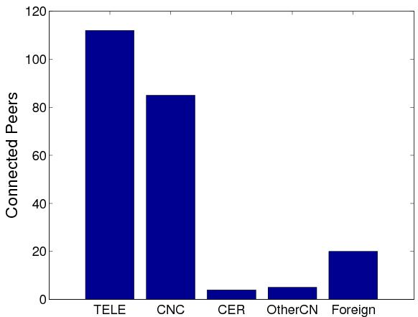
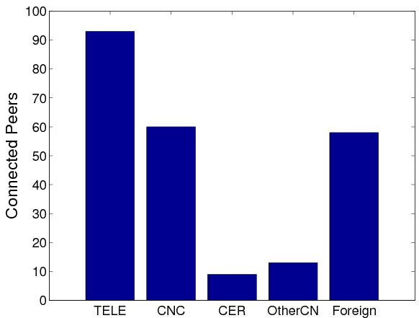
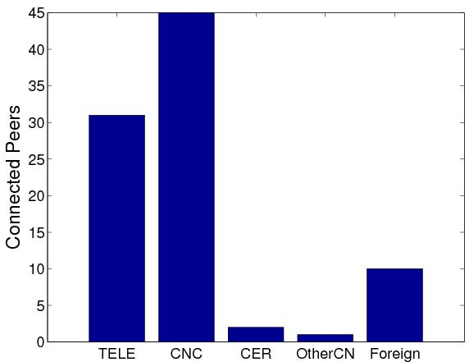
Distribution of Connected Peers (unique)
TELE
TELE
250
120
Connected Peers
Connected Peers
CNC
China-TELE popular
China-TELE unpopular
100
45
Connected Peers
Foreign
Connected Peers
Foreign
USA-Mason popular
USA-Mason unpopular

Slide 27
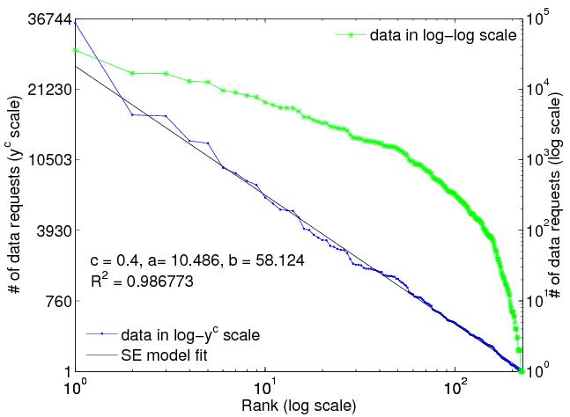
Data Request Distribution
Zipf distribution (power law)
fat head
thin tail
Characterizes the property of scale invariance
Heavy tailed, scale free
log scale
y
log y
log scale in x axis
China-TELE unpopular
slope: -α
heavy tail
i
log i

Slide 28
Zipf model and SE model
Zipf distribution (power law)
SE distribution
Characterizes the property of scale invariance
Heavy tailed, scale free
fat head and thin tail in log-log scale
straight line in logx-y^{c} scale (SE scale)
y
log y
log y
fat head
y^{c}
c: stretch factor
slope: -α
b
slope: -a
heavy tail
thin tail
i
log i
log i
log i

Slide 29
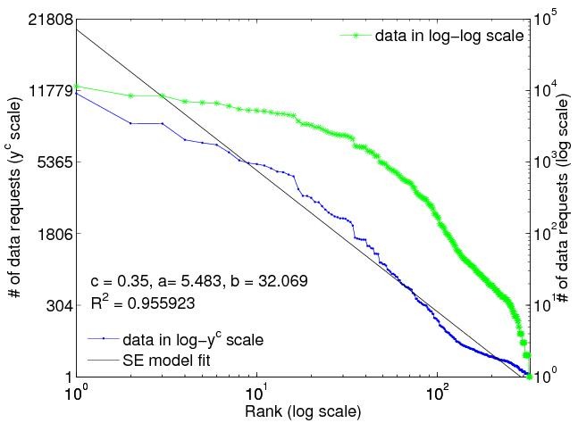
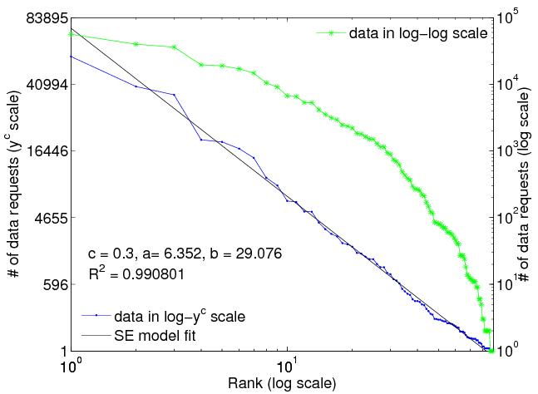
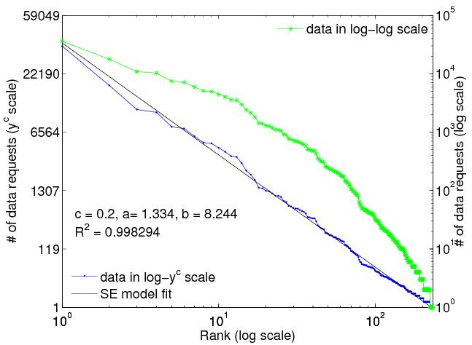
Data Request Distribution
fat head
thin tail
# of data requests
(powered scale y^{c})
# of data requests
(log scale)
log scale in x axis
China-TELE popular
China-TELE unpopular
USA-Mason popular
USA-Mason unpopular

Slide 30
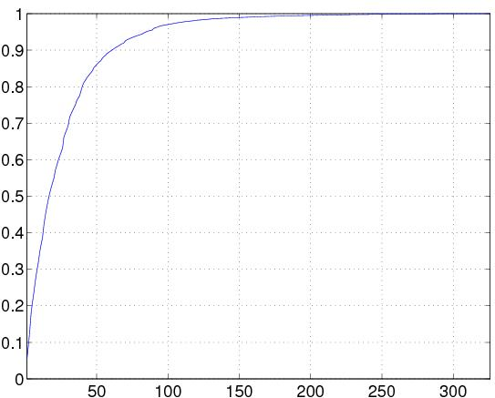
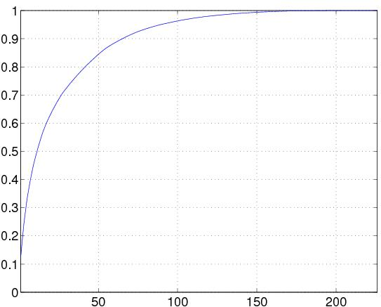
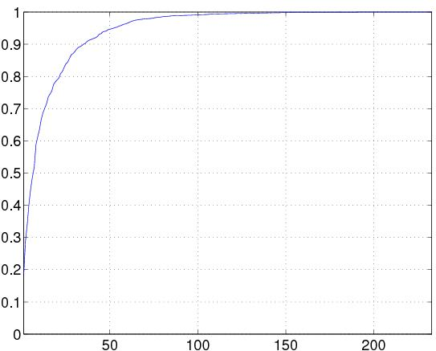
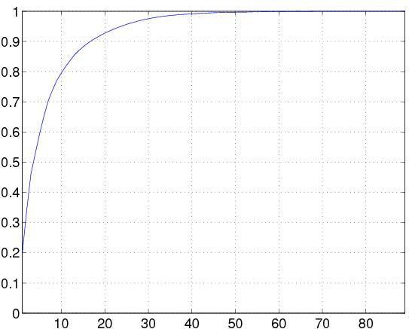
CDF of Peers’ Traffic Contributions
73%
67%
China-TELE popular
China-TELE unpopular
82%
77%
USA-Mason popular
USA-Mason unpopular

Slide 31
Summary (3)
PPLive achieves strong ISP-level traffic locality, especially for popular channels.
Peers in the same ISP tend to respond faster, causing high ISP-level traffic locality.
At peer-level, data requests made by a peer also have strong locality.

Slide 32
Outline
Overview
Returned peer IP addresses
Traffic Locality
Response time
Traffic contribution distribution
Round-trip Time

Slide 33
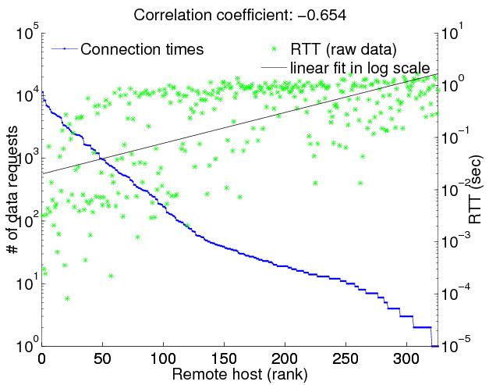
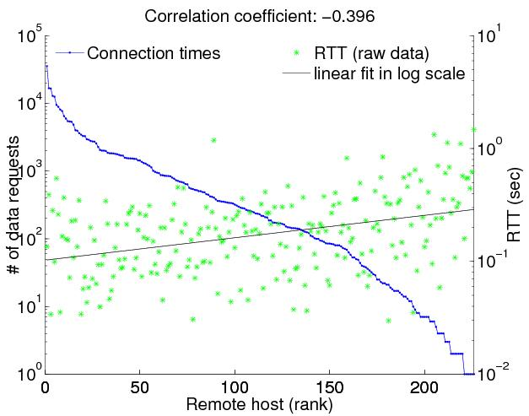
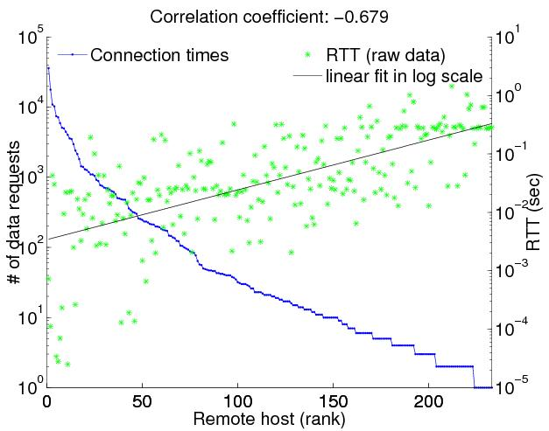
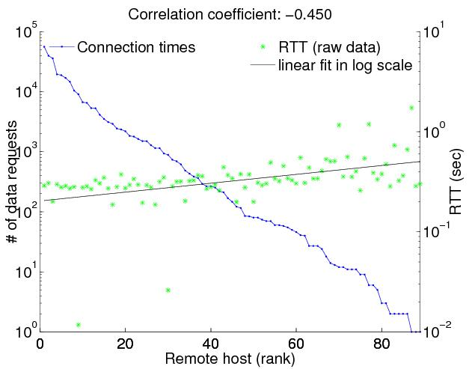
Round-trip Time
-0.654
# of data requests
-0.396
RTT (sec)
Remote host (rank)
China-TELE popular
China-TELE unpopular
-0.679
-0.450
USA-Mason popular
USA-Mason unpopular

Slide 34
Summary (4)
PPLive achieves strong ISP-level traffic locality, especially for popular channels.
Peers in the same ISP tend to respond faster, causing high ISP-level traffic locality.
At peer-level, data requests made by a peer also have strong locality.
Top connected peers have smaller Round-trip time values to our probing clients.

Slide 35
Conclusion
PPLive traffic is highly localized at ISP-level.
Achieved without any special requirement such as ISP or CDN support like P4P and Ono.
Uses a decentralized, latency based, neighbor referral policy.
Automatically addresses the topology mismatch issue to a large extent.
Enhances both user- and network- level performance.

