Slide 1
Testing Web Applications with the
Atomic Section Model
Jeff Offutt
Professor, Software Engineering
George Mason University
Fairfax, VA USA
www.cs.gmu.edu/~offutt/
offutt@gmu.edu
Joint research with Blaine Donley, Upsorn Praphamontripong, Ye Wu

Slide 2
OUTLINE
Motivation
Unique Aspects of Web Software
The Atomic Section Model
Testing with the AtS Model
Other Applications and Summary

Slide 3
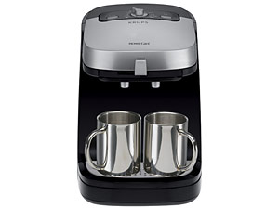

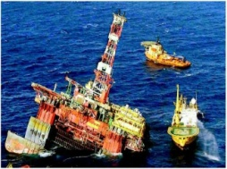
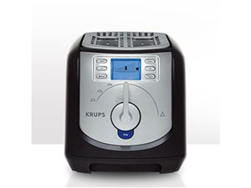

Software is a Skin that Surrounds Our Civilization
Quote due to Dr. Mark Harman

Slide 4
Costly Software Failures
“The Economic Impacts of Inadequate Infrastructure for Software Testing”
  Inadequate software testing costs the US alone between $22 and $59 billion USD annually
  Better testing could cut this amount in half
2006 : Amazon’s BOGO offer became a double discount
2007 : Symantec says that most security vulnerabilities are now due to faulty software
  And more than half are in web applications
Huge losses due to web application failures
  Financial services : $6.5 million per hour (just in USA!)
  Credit card sales applications : $2.4 million per hour (in USA)
World-wide monetary loss due to poor software is staggering

Slide 5
Cost Of Late Testing
60
50
40
30
Fault origin (%)
Fault detection (%)
Unit cost (X)
20
10
0
Requirements
Design
Prog / Unit Test
Integration Test
System Test
Production
Software Engineering Institute; Carnegie Mellon University; Handbook CMU/SEI-96-HB-002
Notes:
28-Oct-2010, at GTAC, added the animation to demonstrate increasing the number of faults found early, thereby decreasing the number of faults found late, and finally saving money. Lots of it! This animation is fairly complicated … must practice first!!

Slide 6
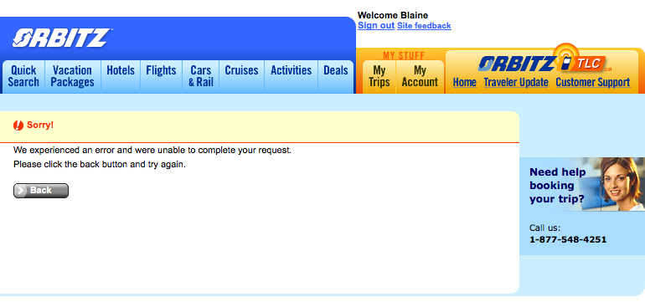
Example Failure 1
Why should I trust you enough to try again?

Slide 7
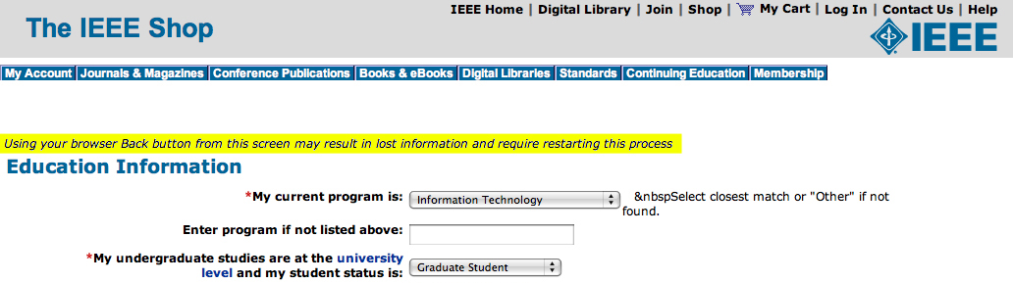
Example Failure 2
Oh yeah?? I’m definitely pushing BACK !

Slide 8
OUTLINE
Motivation
Unique Aspects of Web Software
The Atomic Section Model
Testing with the AtS Model
Other Applications and Summary

Slide 9
Software Deployment Methods
Bundled : On your computer when you buy it
Shrink-wrapped : Bought at a store on a CD
  Downloaded from company’s website or OSS site
Contract : Single customer
Embedded : Installed on an electronic device
Web application : On the web through a URL
  Component-based
  Concurrent / distributed
  Users access same version on the server
  Can be updated at any time (fast update cycle)
  User interactive

Slide 10
Server Side Processing
HTTP Request
data
Web server
UI implemented in a browser
Container engine
Program components
Client
Server
HTML
HTTP Response

Slide 11
Web Software Container Engine
Container engine
Web App 1
Web App 2
C1_{a}
C2_{a}
C2_{b}
C1_{b}
C1_{c}
C2_{d}
C2_{c}
Shared memory
Shared memory
Shared memory

Slide 12
Issues with Programming Web Apps
Control flow
State management and variable scope

Slide 13
Traditional Control Flow
Traditional
  Method / function calls
  Decisions – if, while, for, repeat-until, switch, …
  Static includes – other code pulled in before compiling
OO languages
  Some dynamic binding via polymorphism
Client / Server
  Message passing

Slide 14
Web App Control Flow
Same as traditional – Software on server and client
Message passing :
  Synchronous – Client to server via HTTP
  Asynchronous – Client to server via Ajax
Event handling – on the client
Forward – Transfers control from one server component to another, no return
Redirect – Ask client to send request elsewhere
Operational transitions – URL rewriting, back, forward, …
Dynamic include – Control passes to another component, then returns, no parameters
Dynamic binding – Reflection allows new components

Slide 15
Ramifications
The traditional control flow graph does not model essential parts of web app execution !
UML diagrams do not model many of these
Most developers learn the syntax, but not the concepts behind these new control connections
Lots of poorly designed software …
and lots and lots of poorly understood software faults !

Slide 16
State Management and Variable Scope
HTTP is stateless
Connections between clients and web servers are not maintained
Each request is independent
Control flow repeatedly goes through the client
How can the software keep track of multiple requests from the same user ?
Container engines maintain session data

Slide 17
Sessions—Big Picture
Web Server
Client 1
Client 2
Time
Time
HTTP Request
HTTP Response
HTTP Request
Session ID = 0347
HTTP Response
Session ID = 4403
Server returns a new unique session ID when the request has none
HTTP Request
Session ID = 0347
HTTP Request
HTTP Response
Session ID = 4403
HTTP Response
HTTP Request
Session ID = 0347
HTTP Request
Session ID = 4403
HTTP Response
HTTP Response

Slide 18
Sessions—Big Picture
Web Server
Client 1
Client 2
Time
Time
HTTP Request
HTTP Response
HTTP Request
Session ID = 0347
HTTP Response
Session ID = 4403
HTTP Request
Session ID = 0347
HTTP Request
Client stores the ID and sends it to the server in subsequent requests
Session ID = 4403
HTTP Response
HTTP Response
HTTP Request
Session ID = 0347
HTTP Request
Session ID = 4403
Server recognizes these requests as being from a different client.
Server recognizes all the requests as being from the same client.
This defines a session.
HTTP Response
HTTP Response

Slide 19
Sharing Data : Session Object
One program component can store a value in the session object
Another component can retrieve, use, and modify the value
Depends on the container engine:
  Software components run as threads, not processes
  Container engine stays resident and can keep shared memory
Different programs can share data through the context object

Slide 20
Sharing Data with Scope (JSP)
request
page
forward
request
request
request
Client 1
page
forward
session
request
page
Client 2
application

Slide 21
Control Flow and State Summary
Managing state and control flow is fundamental to any program
These are the most unique aspects of designing and programming web applications
Software vendors are creating new frameworks all the time
  Most introduce additional state handling techniques
Many professional web developers make fundamental mistakes with state and control !
State management is the most common source of software faults in web applications

Slide 22
OUTLINE
Motivation
Unique Aspects of Web Software
The Atomic Section Model
Testing with the AtS Model
Other Applications and Summary

Slide 23
Control Flow Graphs in Web Applications
Many testing criteria on non-Web software rely on a static control flow graph
  Edge testing, data flow, logic coverage …
  Also slicing, change impact analysis, …
The potential flow of control cannot be known statically
  Control flow graphs cannot be computed for Web apps!
But all the pieces of the web pages and programs are contained in the software source …

Slide 24
Atomic Sections
PrintWriter out = response.getWriter();
P1 =
out.println (“<HTML>”)
out.println (“<HEAD><TITLE>” + title + “</TITLE></HEAD>”)
out.println (“<BODY>”)
title
if (isUser) {
Atomic
sections
P2 =
out.println (“<CENTER>Welcome!</CENTER>”);
for (int i=0; i<myVector.size(); i++)
if (myVector.elementAt(i).size > 10)
P3 =
out.println (“<P><B>” + myVector.elementAt(i) + “</B></P>”);
myVector.elementAt (i)
else
P4 =
out.println (“<P>" + myVector.elementAt (i) + “</P>”);
myVector.elementAt (i)
Empty
atomic
section
} else
P5 =
{ }
Content
variables
P6 =
out.println (“</BODY></HTML>”);
out.close ();

Slide 25
Atomic Sections Defined
A section of HTML with the property that if any part of the section is sent to a client, the entire section is
  May include JavaScript
  All or nothing property
An HTML file is an atomic section
Content variable : A program variable that provides data to an atomic section
Atomic sections may be empty

Slide 26
Component Expressions
Atomic sections are combined to create dynamically generated web pages
Four ways to combine:
  Sequence : p1 • p2
  Selection : (p1 | p2)
  Iteration : p1*
  Aggregation : p1 {p2}
    p2 is included inside of p1
The previous example produces:
  p → p1 • (p2 • (p3 | p4)* | p5) • p6

Slide 27
Modeling Component Transitions
Five types of transitions
  Simple Link Transition : An HTML link (<A> tag)
  Form Link Transition : Form submission link
  Component Expression Transition : Execution of a software component causes a component expression to be sent to the client
  Operational Transition : A transition out of the software’s control
    Back button, Forward button, Refresh button, User edits the URL, Browser reloads from cache
  Redirect Transition : Server side transition, invisible to user

Slide 28
gradeServlet Example
ID = request.getParameter ("Id");
passWord = request.getParameter ("Password");
retry = request.getParameter ("Retry");
PrintWriter out = response.getWriter();
P1 =
out.println (“<HTML> <HEAD><TITLE>" + title + "</TITLE></HEAD><BODY>)"
if ((Validate (ID, passWord)) {
P2 =
out.println (“ <B> Grade Report </B>");
for (int i = 0; i < numberOfCourses; i++)
P3 =
out.println(“<P><B>" + courseName (i) + "</B>“ + courseGrade (i) + “</P>”);
} else if (retry < 3) {
P4 =
retry++;
out.println ("Wrong ID or wrong password");
out.println ("<FORM Method=\“get\" Action=\"gradeServlet\">”);
out.println ("<INPUT Type=\“text\" Name=\"Id\" Size=10>");
out.println ("<INPUT Type=\“password\" Name=\"Password\" Width=20>");
out.println ("<INPUT Type=\“hidden\" Name=\"Retry\" Value=" + retry + ">");
out.println ("<INPUT Type=\“submit\" Name=\“Submit\" Value=\“submit\">");
out.println ("<A Href=\"sendMail\">Send mail to the professor</A>");
} else if (retry >= 3) {
P5 =
out.println (“<P>Wrong ID or password, retry limit reached. Good bye.") }
P6 =
out.println(“</BODY></HTML>");

Slide 29
CIM for gradeServlet
S = login.html
A = {p₁, p₂, p₃, p₄, p₅, p₆ }
CE = gradeServlet = p₁ • ((p₂ • p₃* ) | p₄ | p₅) • p₆
T = {login.html gradeServlet [get, (Id, Password, Retry)],
gradeServlet.p₄ sendMail [get, ()],
gradeServlet.p₄ gradeServlet [get, (Retry)] }
Form link transition
Simple link transition

Slide 30
Application Transition Graph
Finite set of web components
  Γ = { login.html, gradeServlet, sendMail, syllabus.html }
Set of transitions among web software components
  Θ = { login.html syllabus.html [get, ()],
login.html gradeServlet [get, (Id, Password, Retry)],
gradeServlet.p₄ sendMail [get, ()],
gradeServlet.p₄ gradeServlet [get, (Retry)] }
Set of variables that define the web application state
  Σ = { Id, Password, Retry }
Set of start pages
  α = { login.html }

Slide 31
ATG for gradeServlet
get ()
get ()
login.html
syllabus.html
get
(Id, Password, Retry)
get (Id, Password, Retry)
gradeServlet
p1
p2
p4
p5
get ()
sendMail
p3
p6

Slide 32
OUTLINE
Motivation
Unique Aspects of Web Software
The Atomic Section Model
Testing with the AtS Model
Other Applications and Summary

Slide 33
Test Criteria
Tests can be applied at the intra- or the inter-component level
Tests are created by deriving sequences of transitions among the web software components and composite sections

Slide 34
Composite Section Test Criteria
Intra-Component
All productions in the grammar
  Multiple forms for each software component
  Each atomic section used at least once
Each selection used once
  Every form element
Each possible aggregation
MCDC type coverage of conditions on productions
  Based on predicates from the software that separate atomic sections

Slide 35
ATG (Inter-Component) Tests
L1 : Evaluate static link transitions
  One test generated for each form
L2 : L1 with two extensions
  Values entered with URL rewriting
  Multiple tests for each form
L3 : Operational transitions
  Starting on non-initial pages, no subsequent transitions
L4 : Operational transitions
  L1 tests with one operational transition at end
L5 : L4 + tests to traverse every transition out of the final page

Slide 36
Empirical Evaluation
Testing STIS
STIS helps users keep track of arbitrary textual information
18 JSPs, 5 Java classes, database
Atomic sections derived automatically
  Parser works on Java servlets, JSPs, Java classes
ATG derived by hand
Form data chosen by hand
109 total tests

Slide 37
STIS Application Transition Graph
index.jsp
post (userid, password)
login.jsp
logout.jsp
record_add.jsp
browse.jsp
categories.jsp
post (name, category, content)
post (category, search_name)
post (action, categoryName)
update_search_params.jsp
record_insert.jsp
simple link transition
forward link transition
form link transition

Slide 38
Results from Testing STIS
previous web tests
109 tests
Failure Category | L1 | L2 | L3 | L4 | L5
Number of tests | 29 | 21 | 7 | 19 | 33
Pages displayed without authentication | 0 | 0 | 2 | 4 | 4
2. Records added without authentication | 0 | 0 | 1 | 2 | 0
3. Runtime failures (unhandled exceptions) | 0 | 3 | 2 | 5 | 2
Total number of failures | 0 | 3 | 5 | 11 | 6
Found 25 naturally occurring failures

Slide 39
OUTLINE
Motivation
Unique Aspects of Web Software
The Atomic Section Model
Testing with the AtS Model
Other Applications and Summary

Slide 40
Atomic Sections Summary
Atomic sections fundamentally model Web applications
  Allow the Web app form of CFGs
Can also be used for
  Software evolution
  Design modeling / evaluation
  Change impact analysis (slicing)
  Coupling of Web application components

Slide 41
Test Design
Human-based test design uses knowledge of the software domain, knowledge of testing, and intuition to generate test values
Criteria-based test design uses engineering principles to generate test values that cover source, design, requirements, or other software artifact
A lot of test educators and researchers have taken an either / or approach – a competitive stance
To test effectively and efficiently, a test organization needs to combine both approaches !
A cooperative stance.

Slide 42
Advantages of Criteria-Based Test Design
Criteria maximize the “bang for the buck”
  Fewer tests that are more effective at finding faults
Comprehensive test set with minimal overlap
Traceability from software artifacts to tests
  The “why” for each test is answered
  Built-in support for regression testing
A “stopping rule” for testing—advance knowledge of how many tests are needed
Natural to automate

Slide 43
Conclusions
The Web provides a new way to deploy software
The new technologies means that old testing techniques do not work very well
New tools and techniques are being developed
Most are still in the research stage
Most companies test web software very badly

Slide 44
References and Contact
Modeling Presentation Layers of Web Applications for Testing, Jeff Offutt and Ye Wu, Springer’s Software and Systems Modeling, 9(2), April 2010
Applying Mutation Testing to Web Applications, Upsorn Praphamontripong and Jeff Offutt. Sixth Workshop on Mutation Analysis (Mutation 2010), April 2010, Paris,France
Testing Web Applications by Modeling with FSMs, Anneliese Andrews, Jeff Offutt and Roger Alexander, Springer’s Software Systems and Modeling, 4(3):326-345, July 2005
Quality Attributes of Web Software Applications, Jeff Offutt, IEEE Software: Special Issue on Software Engineering of Internet Software, March/April 2002
Jeff Offutt
offutt@gmu.edu
http://cs.gmu.edu/~offutt/

