Slide 1
ISA 562
Information Security, Theory and Practice.
Lecture 8: OS security
Slides from Goodrich and Tamassia

Slide 2
Operating Systems Concepts

Slide 3
A Computer Model
An operating system has to deal with the fact that a computer is made up of a CPU, random access memory (RAM), input/output (I/O) devices, and long-term storage.
RAM
0
1
2
3
4
5
6
7
8
9
.
.
.
Disk Drive
I/O
CPU

Slide 4
OS Concepts
An operating system (OS) provides the interface between the users of a computer and that computer’s hardware.
  An operating system manages the ways applications access the resources in a computer, including its disk drives, CPU, main memory, input devices, output devices, and network interfaces.
  An operating system manages multiple users.
  An operating system manages multiple programs.

Slide 5
The Kernel
The kernel is the core component of the operating system. It handles the management of low-level hardware resources, including memory, processors, and input/output (I/O) devices, such as a keyboard, mouse, or video display.
Most operating systems define the tasks associated with the kernel in terms of a layer metaphor, with the hardware components, such as the CPU, memory, and input/output devices being on the bottom, and users and applications being on the top.
User Applications
Userland
Non-essential OS Applications
Operating System
The OS Kernel
CPU, Memory, Input/Output
Hardware

Slide 6
Input/Output
The input/output devices of a computer include things like its keyboard, mouse, video display, and network card, as well as other more optional devices, like a scanner, Wi-Fi interface, video camera, USB ports, etc.
Each such device is represented in an operating system using a device driver, which encapsulates the details of how interaction with that device should be done.
  The application programmer interface (API), which the device drivers present to application programs, allows those programs to interact with those devices at a fairly high level, while the operating system does the “heavy lifting” of performing the low-level interactions that make such devices actually work.

Slide 7
System Calls
User applications don’t communicate directly with low-level hardware components, and instead delegate such tasks to the kernel via system calls.
System calls are usually contained in a collection of programs, that is, a library such as the C library (libc), and they provide an interface that allows applications to use a predefined series of APIs that define the functions for communicating with the kernel.
  Examples of system calls include those for performing file I/O (open, close, read, write) and running application programs (exec).

Slide 8
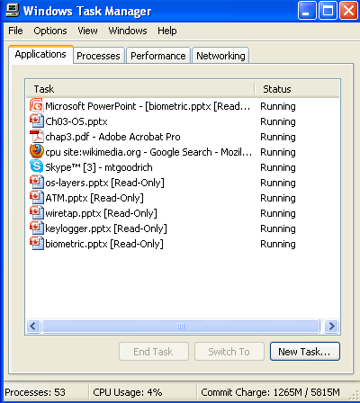
Processes
A process is an instance of a program that is currently executing.
The actual contents of all programs are initially stored in persistent storage, such as a hard drive.
In order to be executed, a program must be loaded into random-access memory (RAM) and uniquely identified as a process.
In this way, multiple copies of the same program can be run as different processes.
  For example, we can have multiple copies of MS Powerpoint open at the same time.

Slide 9
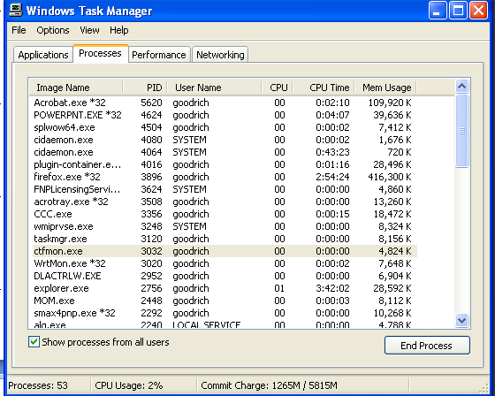
Process IDs
Each process running on a given computer is identified by a unique nonnegative integer, called the process ID (PID).
Given the PID for a process, we can then associate its CPU time, memory usage, user ID (UID), program name, etc.

Slide 10
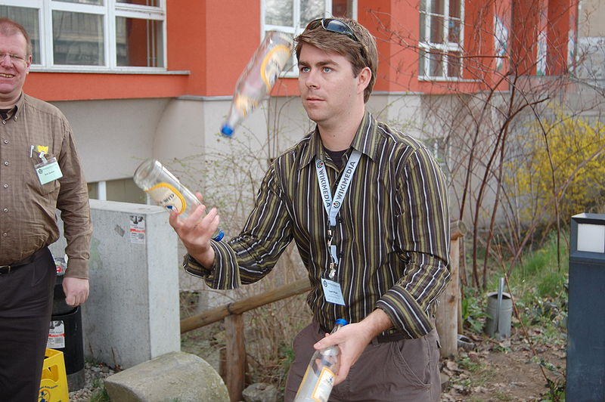
Multitasking
Give each running program a “slice” of the CPU’s time.
The CPU is running so fast that to any user it appears that the computer is running all the programs simultaneously.
Public domain image from http://commons.wikimedia.org/wiki/File:Chapters_meeting_2009_Liam_juggling.JPG

Slide 11
Process Tree
When a user starts a program, the OS sees this as a request by an existing process. E.g. a shell, or a GUI.
The new process is forked from the first, and becomes the child of the parent process.
  The child inherits the permissions of the parent.
In Linux, the root of the process tree is init, which begins during the boot process.
  Init forks processes for user logins.
  It becomes the parent of “orphaned” processes whose parents have terminated.

Slide 12
Process Privileges
The OS associates a user with each running process.
  These dictate which resources the process is allowed to access.
The process also inherits the permissions of the parent process.
In Unix-based OSes, also an effective UID.
  Typically same as user ID, but can be set to be the ID of the application’s owner, which might have more privilege.

Slide 13
File Systems
A filesystem is an abstraction of how the external, nonvolatile memory of the computer is organized.
Operating systems typically organize files hierarchically into folders, also called directories.
Each folder may contain files and/or subfolders.
Thus, a volume, or drive, consists of a collection of nested folders that form a tree.
The topmost folder is the root of this tree and is also called the root folder.

Slide 14
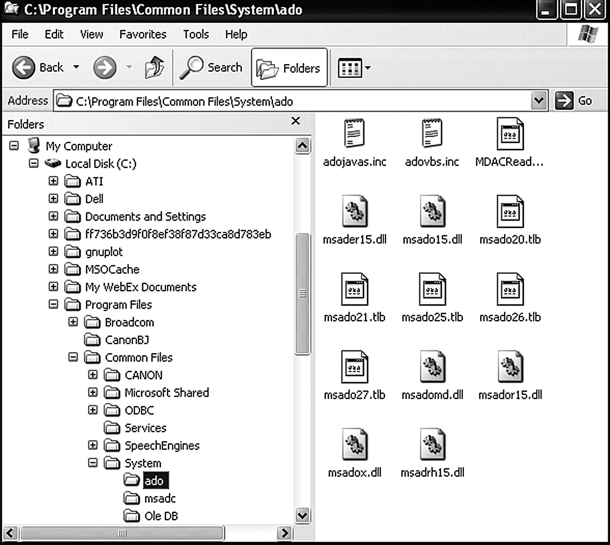
File System Example

Slide 15
File Permissions
File permissions are checked by the operating system to determine if a file is readable, writable, or executable by a user or group of users.
In Unix-like OS’s, a file permission matrix shows who is allowed to do what to the file.
  Files have owner permissions, which show what the owner can do, and group permissions, which show what some group id can do, and world permissions, which give default access rights.

Slide 16
Memory Management
The RAM memory of a computer is its address space.
It contains both the code for the running program, its input data, and its working memory.
For any running process, it is organized into different segments, which keep the different parts of the address space separate.
As we will discuss, security concerns require that we never mix up these different segments.

Slide 17
Memory Organization
Text. This segment contains the actual (binary) machine code of the program.
Data. This segment contains static program variables that have been initialized in the program code.
BSS. This segment, which is named for an antiquated acronym for block started by symbol, contains static variables that are uninitialized.
Heap. This segment, which is also known as the dynamic segment, stores data generated during the execution of a process.
Stack. This segment houses a stack data structure that grows downwards and is used for keeping track of the call structure of subroutines (e.g., methods in Java and functions in C) and their arguments.

Slide 18
Memory Layout

Slide 19
Memory access permissions
Each of the 5 memory segments has its own set of permissions (read, write, execute).
Processes are not allowed to access the address space of other processes, unless explicitly granted permission.
The OS also broadly separates the memory into space for user applications, and space for the kernel.

Slide 20
Virtual Memory
There is generally not enough computer memory for the address spaces of all running processes.
Nevertheless, the OS gives each running process the illusion that it has access to its complete (contiguous) address space.
In reality, this view is virtual, in that the OS supports this view, but it is not really how the memory is organized.
Instead, memory is divided into pages, and the OS keeps track of which ones are in memory and which ones are stored out to disk.
ATM

Slide 21
Page Faults
1. Process requests virtual address not in memory,
causing a page fault.
2. Paging supervisor pages out
an old block of RAM memory.
“read 0110101”
“Page fault,
let me fix that.”
Process
Paging supervisor
old
Blocks in
RAM memory:
new
External disk
3. Paging supervisor locates requested block
on the disk and brings it into RAM memory.

Slide 22
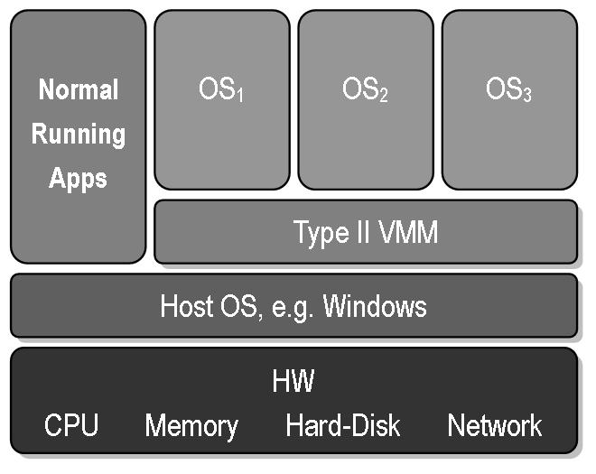
Virtual Machines
Virtual machine: A view that an OS presents that a process is running on a specific architecture and OS, when really it is something else. E.g., a windows emulator on a Mac.
Benefits:
  Hardware Efficiency
  Portability
  Security
  Management
Public domain image from http://commons.wikimedia.org/wiki/File:VMM-Type2.JPG

Slide 23
Operating Systems Security

Slide 24
The Boot Sequence
The action of loading an operating system into memory from a powered-off state is known as booting or bootstrapping.
When a computer is turned on, it first executes code stored in a firmware component known as the BIOS (basic input/output system).
On modern systems, the BIOS loads into memory the second-stage boot loader, which handles loading the rest of the operating system into memory and then passes control of execution to the operating system.

Slide 25
BIOS Passwords
A malicious user could potentially seize execution of a computer at several points in the boot process.
To prevent an attacker from initiating the first stages of booting, many computers feature a BIOS password that does not allow a second-stage boot loader to be executed without proper authentication.

Slide 26
Hibernation
Modern machines have the ability to go into a powered-off state known as hibernation.
While going into hibernation, the OS stores the contents of machine’s memory into a hibernation file (such as hiberfil.sys) on disk so the computer can be quickly restored later.
But… without additional security precautions, hibernation exposes a machine to potentially invasive forensic investigation.
1. User closes a laptop computer,
putting it into hibernation.
2. Attacker copies the hiberfil.sys
file to discover any unencrypted
passwords that were stored
in memory when the computer
was put into hibernation.

Slide 27
Event Logging
Keeping track of what processes are running, what other machines have interacted with the system via the Internet, and if the operating system has experienced any unexpected or suspicious behavior can often leave important clues not only for troubleshooting ordinary problems, but also for determining the cause of a security breach.

Slide 28
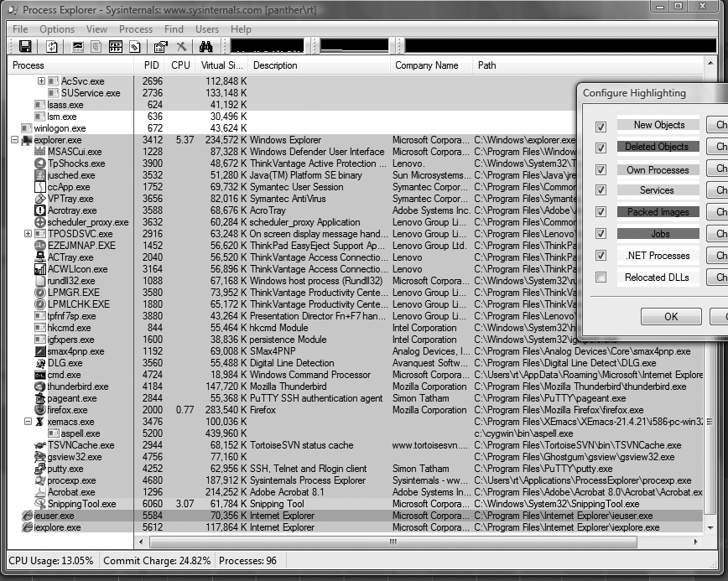
Process Explorer

Slide 29
Memory and Filesystem Security
The contents of a computer are encapsulated in its memory and filesystem.
Thus, protection of a computer’s content has to start with the protection of its memory and its filesystem.

Slide 30
Virtual Memory Security
The virtual memory pages are written to the hard disk, and treated like any other file.
The OS places permissions that protects the file from users… so long as the OS is running.
The OS can be configured to erase these files when it is powered down... so long as it is properly powered down.
Encrypting the hard disk is a good way to protect the virtual memory.

Slide 31
Filesystem Security

Slide 32
Access Control Matrices
A table that defines permissions.
  Each row of this table is associated with a subject, which is a user, group, or system that can perform actions.
  Each column of the table is associated with an object, which is a file, directory, document, device, resource, or any other entity for which we want to define access rights.
  Each cell of the table is then filled with the access rights for the associated combination of subject and object.
  Access rights can include actions such as reading, writing, copying, executing, deleting, and annotating.
  An empty cell means that no access rights are granted.

Slide 33
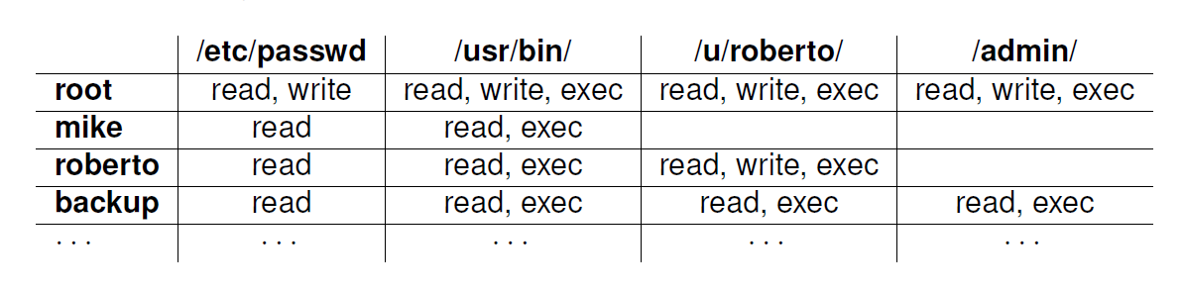
Example Access Control Matrix

Slide 34
Access Control Matrices
Main drawback: most subjects do not have any rights to most objects.
It is a sparce matrix! A lot of wasted space.

Slide 35
Access Control Lists
It defines, for each object, o, a list, L, called o’s access control list, which enumerates all the subjects that have access rights for o and, for each such subject, s, gives the access rights that s has for object o.
/etc/passwd
/usr/bin/
/u/roberto/
/admin/
root: r,w
mike: r
roberto: r
backup: r
root: r,w,x
mike: r,x
roberto: r,x
backup: r,x
root: r,w,x
roberto: r,w,x
backup: r,x
root: r,w,x
backup: r,x

Slide 36
Access Control Lists
Main drawback: hard to find all objects that a given subject can access.
Imagine removing a user from the system.

Slide 37
Capabilities
/etc/passwd: r,w,x; /usr/bin: r,w,x;
/u/roberto: r,w,x; /admin/: r,w,x
root
Takes a subject-centered approach to access control. It defines, for each subject s, the list of the objects for which s has nonempty access control rights, together with the specific rights for each such object.
mike
/usr/passwd: r; /usr/bin: r,x
/usr/passwd: r; /usr/bin: r;
/u/roberto: r,w,x
roberto
/etc/passwd: r,x; /usr/bin: r,x;
/u/roberto: r,x; /admin/: r,x
backup

Slide 38
Role-based Access Control
Define roles and then specify access control rights for these roles, rather than for subjects directly.
Department Chair
Administrative Manager
Lab Manager
System Administrator
Undergraduate TA
Graduate TA
Accountant
Secretary
Lab Technician
Backup Agent
Undergraduate Student
Graduate Student
Administrative Personnel
Technical Personnel
Faculty
Student
Department Member

Slide 39
General Principles
Files and folders are managed by the operating system
Applications, including shells, access files through an API
Access control entry (ACE)
  Allow/deny a certain type of access to a file/folder by user/group
Access control list (ACL)
  Collection of ACEs for a file/folder
A file handle provides an opaque identifier for a file/folder
File operations
  Open file: returns file handle
  Read/write/execute file
  Close file: invalidates file handle
Hierarchical file organization
  Tree (Windows)
  DAG (Linux)

Slide 40
Discretionary Access Control (DAC)
Users can protect what they own
  The owner may grant access to others
  The owner may define the type of access (read/write/execute) given to others
DAC is the standard model used in operating systems
Mandatory Access Control (MAC)
  Alternative model not covered in this lecture
  Multiple levels of security for users and documents
  Read down and write up principles
Notes:
Ripasso DAC

Slide 41
Closed vs. Open Policy
Closed policy
  Also called “default secure”
Give Tom read access to “foo”
Give Bob r/w access to “bar
Tom: I would like to read “foo”
  Access allowed
Tom: I would like to read “bar”
  Access denied
Open Policy
Deny Tom read access to “foo”
Deny Bob r/w access to “bar”
Tom: I would like to read “foo”
  Access denied
Tom: I would like to read “bar”
  Access allowed
Notes:
Default sicuro

Slide 42
Closed Policy with Negative
Authorizations and Deny Priority
Give Tom r/w access to “bar”
Deny Tom write access to “bar”
Tom: I would like to read “bar”
  Access allowed
Tom: I would like to write “bar”
  Access denied
Policy is used by Windows to manage access control to the file system

Slide 43
Access Control Entries and Lists
An Access Control List (ACL) for a resource (e.g., a file or folder) is a sorted list of zero or more Access Control Entries (ACEs)
An ACE specifies that a certain set of accesses (e.g., read, execute and write) to the resources is allowed or denied for a user or group
Examples of ACEs for folder “Bob’s CS167 Grades”
  Bob; Read; Allow
  TAs; Read; Allow
  TWD; Read, Write; Allow
  Bob; Write; Deny
  TAs; Write; Allow

Slide 44
Linux vs. Windows
Linux
  Allow-only ACEs
  Access to file depends on ACL of file and of all its ancestor folders
  Start at root of file system
  Traverse path of folders
  Each folder must have execute (cd) permission
  Different paths to same file not equivalent
  File’s ACL must allow requested access
Windows
  Allow and deny ACEs
  By default, deny ACEs precede allow ones
  Access to file depends first on file’s ACL
  Permissions set on a folder can be set to propagate to descendants (inheritance)
  System keeps track of inherited ACE’s. Lower priority than object’s ACE.

Slide 45
Linux File Access Control
File Access Control for:
  Files
  Directories
  Therefore…
    \dev\ : devices
    \mnt\ : mounted file systems
    What else? Sockets, pipes, symbolic links…
Notes:
Because of the way devices and mounted file systems are represented in Linux as part of the file system, they are also covered by the same access control scheme as normal files.

Slide 46
Linux File System
Tree of directories (folders)
Each directory has links to zero or more files or directories
Hard link
  From a directory to a file
  The same file can have hard links from multiple directories, each with its own filename, but all sharing owner, group, and permissions
  File deleted when no more hard links to it
Symbolic link (symlink)
  From a directory to a target file or directory
  Stores path to target, which is traversed for each access
  The same file or directory can have multiple symlinks to it
  Removal of symlink does not affect target
  Removal of target invalidates (but not removes) symlinks to it
  Analogue of Windows shortcut or Mac OS alias
  Permissions of the target are checked before read/write. Permissions of the symlink are irrelevant.

Slide 47
Exploiting Symbolic Links
Consider a program that allows a user to specify a program to open and read.
  Program specifically checks that the file is not
  /etc/passwd.
  Doesn’t check whether it is a symbolic link to /etc/passwd.
Should either check if it is a symlink, or use a stat system call which provides file information.
Windows offers symlinks, but also shortcuts:
  Also point to files, but not automatically resolved by OS.
  Instead have to specify their use as shortcuts in a program.
  Provides security, but removes some of the flexibility.

Slide 48
In class exercise
On Unix systems, a convenient way of packaging a collection of files is a SHell ARchive, or shar file. A shar file is a shell script that will unpack itself into the appropriate files and directories. Shar files are created by the shar command. The implementation of the shar command in a legacy version of the HP-UX operating system created a temporary file with an easily predictable filename in directory /tmp. This temporary file is an intermediate file that is created by shar for storing temporary contents during its execution. Also, if a file with this name already exists, then shar opens the file and overwrites it with temporary contents. If directory /tmp allows anyone to write to it, a vulnerability exists. An attacker can exploit such a vulnerability to overwrite a victim’s file. (1) What knowledge about shar should the attacker have? (2) Describe the command that the attacker issues in order to have shar overwrite an arbitrary file of a victim. Hint: the command is issued before shar is executed. (3) Suggest a simple fix to the shar utility to prevent the attack. Note that this is not a setuid question.

Slide 49
Unix Permissions
Standard for all UNIXes
Every file is owned by a user and has an associated group
Permissions often displayed in compact 10-character notation
To see permissions, use ls –l
jk@sphere:~/test$ ls –l
total 0
-rw-r----- 1 jk ugrad 0 2005-10-13 07:18 file1
-rwxrwxrwx 1 jk ugrad 0 2005-10-13 07:18 file2

Slide 50
Permissions Examples (Regular Files)
-rw-r—r--
read/write for owner, read-only for everyone else
-rw-r-----
read/write for owner, read-only for group, forbidden to others
-rwx------
read/write/execute for owner, forbidden to everyone else
-r--r--r--
read-only to everyone, including owner
-rwxrwxrwx
read/write/execute to everyone

Slide 51
Permissions for Directories
Permissions bits interpreted differently for directories
Read bit allows listing names of files in directory, but not their properties like size and permissions
Write bit allows creating and deleting files within the directory
Execute bit allows entering the directory and getting properties of files in the directory
Lines for directories in ls –l output begin with d, as below:
jk@sphere:~/test$ ls –l
Total 4
drwxr-xr-x 2 jk ugrad 4096 2005-10-13 07:37 dir1
-rw-r--r-- 1 jk ugrad 0 2005-10-13 07:18 file1

Slide 52
Permissions Examples (Directories)
drwxr-xr-x
all can enter and list the directory, only owner can add/delete files
drwxrwx---
full access to owner and group, forbidden to others
drwx--x---
full access to owner, group can access known filenames in directory, forbidden to others
-rwxrwxrwx
full access to everyone

Slide 53
Special Permission Bits
Three other permission bits exist
  Set-user-ID (“suid” or “setuid”) bit
  Set-group-ID (“sgid” or “setgid”) bit
  Sticky bit

Slide 54
Set-user-ID
Set-user-ID (“suid” or “setuid”) bit
  On executable files, causes the program to run as file owner regardless of who runs it
  Ignored for everything else
  In 10-character display, replaces the 4th character (x or -) with s (or S if not also executable)
    -rwsr-xr-x: setuid, executable by all
    -rwxr-xr-x: executable by all, but not setuid
    -rwSr--r--: setuid, but not executable - not useful

Slide 55
Set-user-ID
Suppose a user wants to change their entry in /etc/passwd.
  They shouldn’t have permission to read/write.
  They should be able to change their own entry!
The passwd executable has the setuid bit set.
  Even when run by a user in the “other” category, it is still given the privileges of the owner, which is root.
  Useful, but dangerous!

Slide 56
Root
“root” account is a super-user account, like Administrator on Windows
Multiple roots possible
File permissions do not restrict root
This is dangerous, but necessary, and OK with good practices
Notes:
There can be multiple root accounts, but root is the conventional name. Any account with user ID 0 has root powers. This is like the Windows Administrators group. As the system administrator, root can change any file’s owner, group, or permissions, or delete the file, regardless of who owns it or its permissions. This is clearly dangerous, but necessary, and in practice can be secure. Choosing a good root password is very important, as well as minimizing programs and commands which are run as root. Finally, root is the entity charged with making sure that permissions allow no other users to disrupt the system (accidentally or intentionally), but there is nobody doing oversight on root. Thus, it is wise to think twice before doing anything as root, to guard against mistakes.

Slide 57
Changing Permissions
Permissions are changed with chmod or through a GUI like Konqueror
Only the file owner or root can change permissions
If a user owns a file, the user can use chgrp to set its group to any group of which the user is a member
root can change file ownership with chown (and can optionally change group in the same command)
chown, chmod, and chgrp can take the -R option to recur through subdirectories

Slide 58
Examples of Changing Permissions
chown -R root dir1
Changes ownership of dir1 and everything within it to root
chmod g+w,o-rwx file1 file2
Adds group write permission to file1 and file2, denying all access to others
chmod -R g=rwX dir1
Adds group read/write permission to dir1 and everything within it, and group execute permission on files or directories where someone has execute permission
chgrp testgrp file1
Sets file1’s group to testgrp, if the user is a member of that group
chmod u+s file1
Sets the setuid bit on file1. (Doesn’t change execute bit.)

Slide 59
Octal Notation Examples
644 or 0644
read/write for owner, read-only for everyone else
775 or 0775
read/write/execute for owner and group, read/execute for others
640 or 0640
read/write for owner, read-only for group, forbidden to others
2775
same as 775, plus setgid (useful for directories)
777 or 0777
read/write/execute to everyone (dangerous!)
1777
same as 777, plus sticky bit

Slide 60
Limitations of Unix Permissions
Unix permissions are not perfect
  Groups are restrictive
  Limitations on file creation
Linux optionally uses POSIX ACLs
  Builds on top of traditional Unix permissions
  Several users and groups can be named in ACLs, each with different permissions
  Allows for finer-grained access control
Each ACL is of the form type:[name]:rwx
  Setuid, setgid, and sticky bits are outside the ACL system
Notes:
60
Unix permissions are not perfect. There is, for instance, no way to have specific permissions for two or three users, groups, etc. There is also limited ability to set permissions on newly created files, and non-root users cannot create groups and may only use the groups provided by root. At some risk of giving away the next slide, an optional solution is provided in POSIX ACLs.
Linux supports Access Control Lists (ACLs) specified by a POSIX draft standard, which works with Linux filesystems such as Ext2, Ext3, XFS, JFS, and ReiserFS. ACLs build on top of traditional Unix permissions, which still work, but allow for finer-grained access control. Several users and groups can be named in ACLs, each with different permissions. POSIX ACLs also permits a default ACLs for new files within directories.

Slide 61
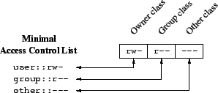
Minimal ACLs
In a file with minimal ACLs, name does not appear, and the ACLs with type “user” and “group” correspond to Unix user and group permissions, respectively.
  When name is omitted from a “user” type ACL entry, it applies to the file owner.
Notes:
61

Slide 62
ACL Commands
ACLs are read with the getfacl command and set with the setfacl command.
Changing the ACLs corresponding to Unix permissions shows up in ls -l output, and changing the Unix permissions with chmod changes those ACLs.
Example of getfacl:
jimmy@techhouse:~/test$ ls -l
total 4
drwxr-x--- 2 jimmy jimmy 4096 2005-12-02 04:13 dir
jimmy@techhouse:~/test$ getfacl dir
# file: dir
# owner: jimmy
# group: jimmy
user::rwx
group::r-x
other::---
Notes:
62

Slide 63
More ACL Command Examples
jimmy@techhouse:~/test$ setfacl -m group::rwx dir
jimmy@techhouse:~/test$ ls -l
total 4
drwxrwx--- 2 jimmy jimmy 4096 2005-12-02 04:13 dir
jimmy@techhouse:~/test$ chmod 755 dir
jimmy@techhouse:~/test$ getfacl dir
# file: dir
# owner: jimmy
# group: jimmy
user::rwx
group::r-x
other::r-x
Notes:
63
Note that in the first example, the setfacl command changed the permissions just like chmod would. In the second, chmod's permissions change is reflected in the getfacl output.

Slide 64
Extended ACLs
ACLs that say more than Unix permissions are extended ACLs
  Specific users and groups can be named and given permissions via ACLs, which fall under the group class (even for for ACLs naming users and not groups)
With extended ACLs, mapping to and from Unix permissions is a bit complicated.
User and other classes map directly to the corresponding Unix permission bits
Group class contains named users and groups as well as owning group permissions. How to map?
Notes:
64

Slide 65
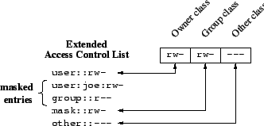
Mask-type ACLs
Unix group permissions now map to an ACL of type “mask”, which is an upper bound on permissions for all group class ACLs.
All group class ACLs are logically and-ed with the mask before taking effect
  rw-—xrw- & r-x—x--- = r----x--
The ACL of type “group” with no name still refers to the Unix owning group
Mask ACLs are created automatically with the necessary bits such that they do not restrict the other ACLs at all, but this can be changed
Notes:
65

Slide 66
Extended ACL Example
jimmy@techhouse:~/test$ ls -l
total 4
drwxr-xr-x 2 jimmy jimmy 4096 2005-12-02 04:13 dir
jimmy@techhouse:~/test$ setfacl -m user:joe:rwx dir
jimmy@techhouse:~/test$ getfacl dir
# file: dir
# owner: jimmy
# group: jimmy
user::rwx
user:joe:rwx
group::r-x
mask::rwx
other::r-x
jimmy@techhouse:~/test$ ls -l
total 8
drwxrwxr-x+ 2 jimmy jimmy 4096 2005-12-02 04:13 dir
Notes:
66

Slide 67
Extended ACL Example Explained
The preceding slide grants the named user joe read, write, and execute access to dir.
  dir now has extended rather than minimal ACLs.
The mask is set to rwx, the union of the two group class ACLs (named user joe and the owning group).
In ls -l output, the group permission bits show the mask, not the owning group ACL
  Effective owning group permissions are the logical and of the owning group ACL and the mask, which still equals r-x.
  This could reduce the effective owning group permissions if the mask is changed to be more restrictive.
The + in the ls -l output after the permission bits indicates that there are extended ACLs, which can be viewed with getfacl.
Notes:
67

Slide 68

NTFS Permissions
ACL
NTFS Partition
Read
User 1
Read
ACE
User 1
Group 1
Full Control
ACE
User 2
Full Control
Group 1

Slide 69
Basic NTFS Permissions

Slide 70
Multiple NTFS permissions
NTFS permissions are cumulative
File permissions override folder permissions
Deny overrides Allow
User 1
Read
Read/Write
Folder A
Group B
Group B
Write
User 1
File1
File2
Group A
Group A
Write denied

Slide 71
NTFS: permission inheritance
Permission Inheritance
Read/Write
Folder A
Access allowed for File 1
File1
Block of Inheritance
Read/Write
Folder A
File1
Access denied for File 1

Slide 73


NTFS File Permissions
Explicit: set by the owner for each user/group.
Inherited: dynamically inherited from the explicit permissions of ancestor folders.
Effective: obtained by combining the explicit and inherited permission.
inherited
Determining effective permissions:
  By default, a user/group has no privileges.
  Explicit permissions override conflicting inherited permissions.
  Denied permissions override conflicting allowed permissions.
Rules
effective
explicit

Slide 74
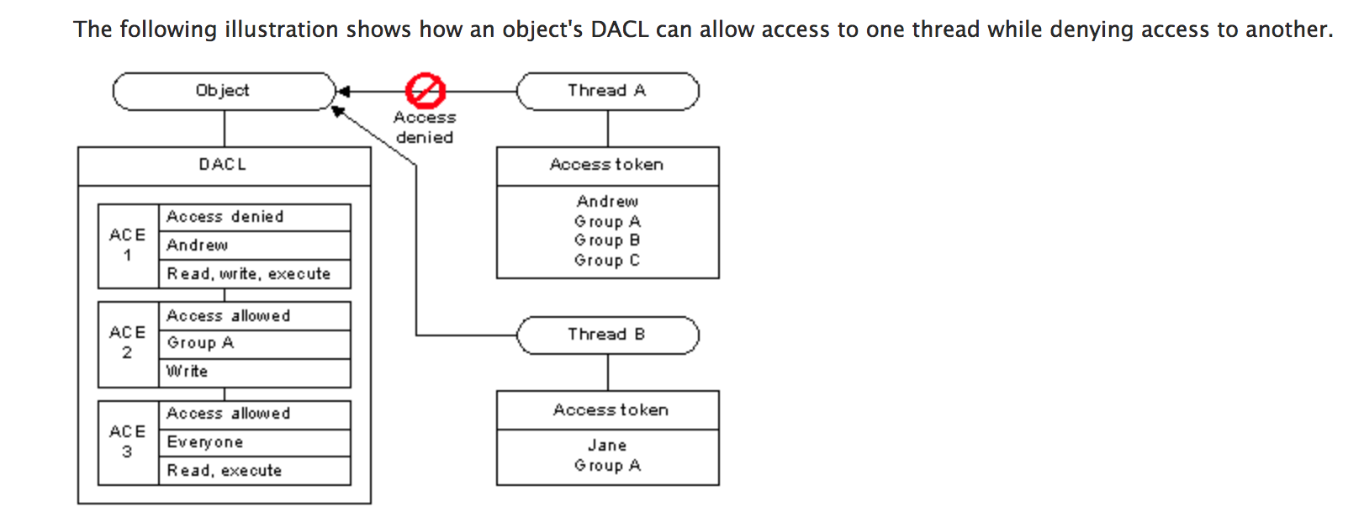
Example

Slide 75
Access Control Algorithm
The ACL of a file or folder is a sorted list of ACEs
  Local ACEs precede inherited ACEs
  ACEs inherited from folder F precede those inherited from parent of F
  Among those with same source, Deny ACEs precede Allow ACEs
Algorithm for granting access request (e.g., read and execute):
  ACEs in the ACL are examined in order
  Does the ACE refer to the user or a group containing the user?
  If so, do any of the accesses in the ACE match those of the request?
  If so, what type of ACE is it?
    Deny: return ACCESS_DENIED
    Allow: grant the specified accesses and if there are no remaining accesses to grant, return ACCESS_ALLOWED
  If we reach the end of the ACL and there are remaining requested accesses that have not been granted yet, return ACCESS_DENIED

Slide 76
Example
Customers Group
Write Folder1
Marketing Group Read Folder1
NTFS
Folder1
Customers Group
Customers Group
Read Folder1
Marketing Group Write Folder2
File1
User1
Folder2
Customers Group
Modify Folder1
File2 should only be accessible to Marketing Group, and only for read access
File2
Marketing Group

Slide 77
NTFS move vs. copy in same volume
Move
NTFS E:\
Copy
If you move a file or a folder inside the same volume your permission will be the same of the source folder
If you copy a file or a folder inside the same volume your permission will be the same of the destination folder

Slide 78
NTFS move vs. copy across volumes
NTFS C:\
NTFS E:\
Copy
NTFS D:\
Move
If you copy or move a file or a folder on different volumes your permission will be the same of the destination folder

Slide 79
Acknowledgment
Much of these POSIX ACL slides are adapted (and some pictures are taken) from Andreas Grünbacher’s paper POSIX Access Control Lists on Linux, available online at:
http://www.suse.de/~agruen/acl/linux-acls/
Notes:
79

Slide 80
File Descriptors
Kernel is responsible for read/write to file.
Program makes a system call: open(filename).
Kernel
  Checks the permissions on the file, and
  provides a descriptor: index in a table, maps to file’s location on disk.
Program makes r/w calls to the descriptor.
  Kernel checks permissions at this time as well.

Slide 81
File Descriptor Leaks
File descriptors can be passed from one process to another.
Kernel only checks permissions of the process at the time the file is opened.
  If a process opens some files, then forks before closing them, the file descriptors are given over.
  If the child process has lower privileges, it will still be granted the parent’s permissions!

Slide 82
Disk encryption
Full disk encryption
The entire filesystem is encrypted using a single key or password, or both (2 factor).
  This includes metadata, file names, folder names, etc.
  Also includes swap files (i.e. virtual memory).
  Does not necessarily include the boot sector, since the OS needs to load before decryption can occur.
“Transparent”: When accessing the disk after bootup, enter key, and that’s it.
  Files are decrypted by the kernel, using device drivers, as they are read and encrypted as they are written.

Slide 83
Disk encryption
Filesystem-level encryption
Select portions of the filesystem is encrypted. Each portion might have its own password or key.
  This does not includes metadata, file names, folder names, etc.
If an attacker gains access to the system during runtime, they still cannot read these files.

