Slide 1
ISA 562
Information Security, Theory and Practice.
Lecture 12: Operations Security

Slide 2
Operations Security

Slide 3
Operations Security
Deals with security issues relating to people, data, media and hardware.
Both internal and external actors.
Both intentional and unintentional threats.

Slide 4
Administrative security
Management of employees to effectively protect information.
Compartmentalize data using labels (e.g. “internal”, “public”, “secret”, “top-secret”).
Determine user clearance level based upon “need to know” principal, and possibly based on background checks.
Separation of duties, and redundancy
No one person should handle multiple duties.
The person authorizing payment shouldn’t also handle accounting.
No one duty should be handled by only one person.
Require 2 signatures on a check.
Rotation of duties: employees see each other’s work.
Non Disclosure Agreements
Background checks

Slide 5
Handling sensitive data
Data must be located and appropriately marked.
It might exist in mult. places: backups, transfers.
Handling: ensure policies are in place controlling
who can handle sensitive data.
How written logs will be kept of who is currently responsible for the media.
Storage: Sensitive data should be encrypted while in storage.

Slide 6
Handling sensitive data
Retention: sensitive data should be kept only as long as it is needed, or as long as obligated.
Destruction: different media require different methods for safely destroying the data.
Wiping: write 0 bits over the data.
Degausser: introduce a magnetic field to destroy the media.
Physical destruction: incineration or pulverization.

Slide 7
Asset Security
Configuration Management
Disabling unnecessary services / programs.
Enabling security services
Firewalls, IDS, malware detection software, backup systems, logging systems.
Baselining: Figuring out the necessary “re-start point” for security in your system.
Removing default logins on components,
Installing key patches and updates in system components.
Vulnerability management
Establish methods for finding vulnerabilities.
Establish methods for handling them after they are found.
Change management
Establish safe practices for adopting changes to the system, software and hardware.

Slide 8
Asset Security
Example from Fresno State Technology services:
Minimum Security Baseline
All network connected devices able to must be configured to meet the minimum security baseline. The baseline security safeguards listed below are the minimum required to protect devices.
Anti-virus software must be enabled, running, and up-to-date on every device.
the built-in (native) firewall of a device or a more advanced firewall must be active. Firewall configurations must permit and allow for policy compliance verification.
Applications and operating system software running on devices must be a supported version.
the installation of relevant software updates, patches, or upgrades fixing critical or high security vulnerabilities of devices must be prompt.

Slide 9
Continuity of operations
Service level agreements:
Define the obligations of the system. E.g. bandwidth or timeliness constraints.
Security measures should protect those requirements.
Fault tolerance should be built into the system in order to ensure that.

Slide 10
Continuity of operations
Fault Tolerance
Backups
Full backups archive everything on disk
Differential backups archive only what has been modified since the last full backup.
Incremental backups archive whatever has been modified since the last backup of any kind.
Example: full backups on Sundays, differential or incremental on weekdays. Data lost on Wednesday.

Slide 11
Continuity of operations
Redundant Array of Inexpensive Disks (RAID)
RAID 0: stripe the data, making reading and writing more efficient. No redundancy!
RAID 1: Mirrored data: complete copy of data.
RAID 3-4: Striped data, and an extra disk to store the parity of the other disks.
B1 | B2 | B1+B2
B3 | B4 | B3+B4
B5 | B6 | B5+B6
B7 | B8 | B7+B8

Slide 12
Continuity of operations
Redundant Array of Inexpensive Disks (RAID)
RAID 5: Striped data, distributed parity values.
RAID 6: dual parity, tolerating 2 failures.
B1 | B2 | B1+B2
B3 | B3+B4 | B4
B5+B6 | B5 | B6
B7 | B8 | B7+B8

Slide 13
Continuity of operations
In addition to data failures, need to also defend against system failures. E.g. what about the system that reads and processes the data?
Redundant hardware: some systems will duplicate the hardware that is prone to failure. E.g. backup power supply.
Redundant systems: you can have a backup of the full system, duplicating all hardware and software.

Slide 14
Continuity of operations
Load Balancing: DNS Round Robin
List multiple A records for the same domain.
DNS servers often return the list in random order. (alternatively, the name resolver might choose, or the client can choose.)
Client chases the first IP on the list, might try other ones after a timeout, or might re-fetch.
Drawbacks:
If a server goes down, it’s IP is still served in responses.
No consideration for anything other than # of requests.

Slide 15
Continuity of operations
Load Balancing: DNS Delegation
List multiple name servers, each returning its own IP address.
one.example.org A 192.0.2.1 two.example.org A 203.0.113.2 www.example.org NS one.example.org www.example.org NS two.example.org
@ IN A 192.0.2.1 @ IN A 203.0.113.2

Slide 16
Continuity of operations
Load Balancing: DNS Delegation
List multiple name servers, each returning its own IP address.
Both name servers are in the response of the higher-level server; the client will contact both.
Whichever replies first will “win” and be used.
If one server is down, it will not reply and won’t be contacted at all.
If one is overloaded, it will naturally reply slower.
If one is geographically closer, it will be chosen first.

Slide 17
Continuity of operations
Load Balancing: dedicated hardware/software
Instead of relying on DNS, can purchase products that will be more clever.
Assymetric loads
Special hardware for processing HTTPS
Priority queuing / rate shaping

Slide 18
Risk Analysis
A vulnerability is announced.
Your company usually tests software updates for 1 week before rolling them out.
There is risk of an exploit, which is spreading around the Internet.
What should you do?

Slide 19
Risk Analysis
Risk depends:
the magnitude of the threat,
how vulnerable the system is,
The cost of an attack.
Risk = threat X vulnerability X cost.

Slide 20
Risk Analysis
Example: Earthquakes.
Threat of an earthquake: San Francisco > Boston
Vulnerability: Boston > San Francisco
Cost: Boston = San Francisco
Risk due to earthquake is the same!
Boston is still less likely to have any costs. But if they do, costs will be higher because they are more vulnerable. More variance. Same expected cost.

Slide 21
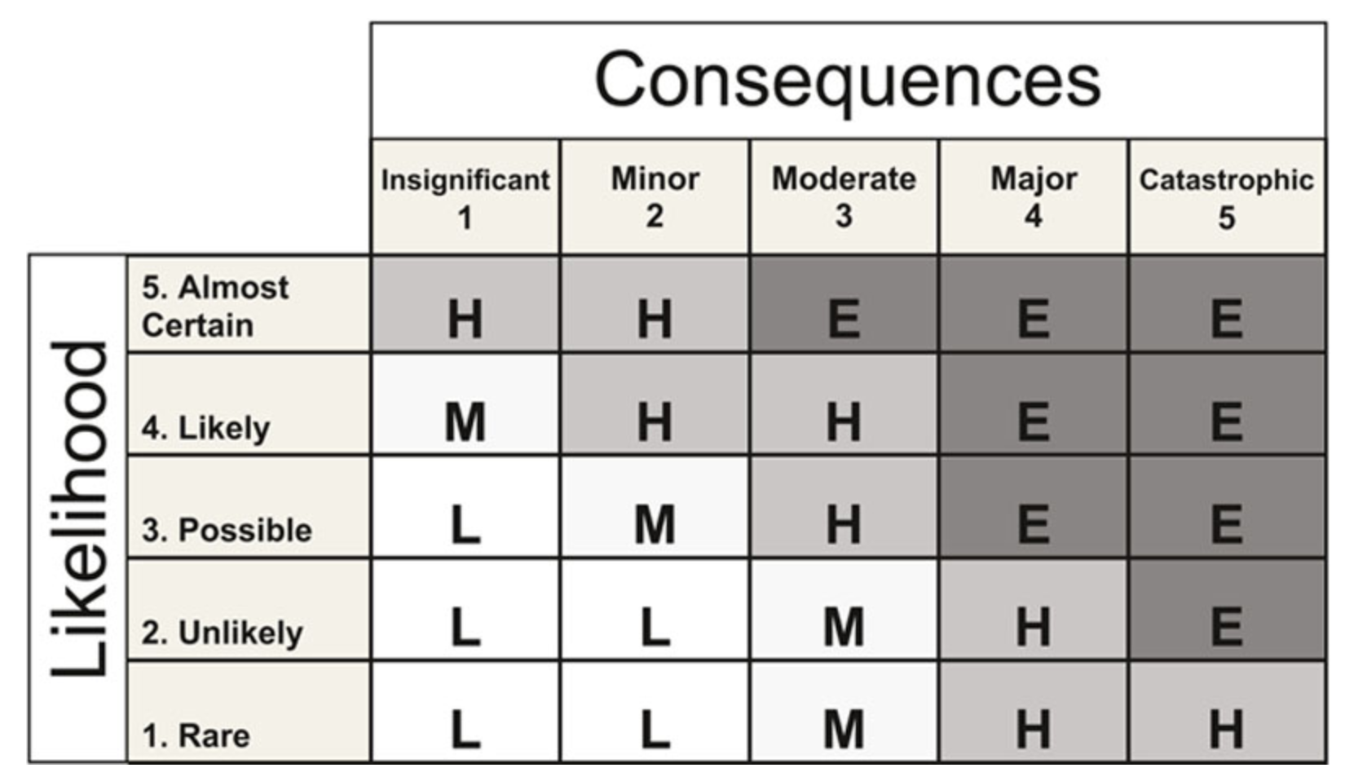
Risk Analysis
Reference: Australia/New Zealand ISO 31000:2009 Risk Management – Principles and Guidelines

Slide 22
Risk Analysis
Annualized Loss Expectancy
Calculate the yearly expected loss due to a risk
(Single loss expectancy) X (Annual Rate of Occurrence)

Slide 23
Risk Analysis
Annualized Loss Expectancy
Calculate the yearly expected loss due to a risk
(Single loss expectancy) X (Annual Rate of Occurrence) =
(Asset Value) X (Exposure Factor) X (ARO)

Slide 24
Risk Analysis
Annualized Loss Expectancy: Asset Value
Consider a laptop. Cost of replacement is easy to calculate. What about the data on the laptop? Loss of competitive advantage (IP)? Reputation? Time required for setting up the new laptop?
Complicated.

Slide 25
Risk Analysis
Annualized Loss Expectancy
Calculate the yearly expected loss due to a risk
(Single loss expectancy) X (Annual Rate of Occurrence) =
(Asset Value) X (Exposure Factor) X (ARO)
Exposure factor: percentage of value the asset is expected to lose due to the incident.
Annual rate of occurrence: how often the incident is expected to occur.

Slide 26
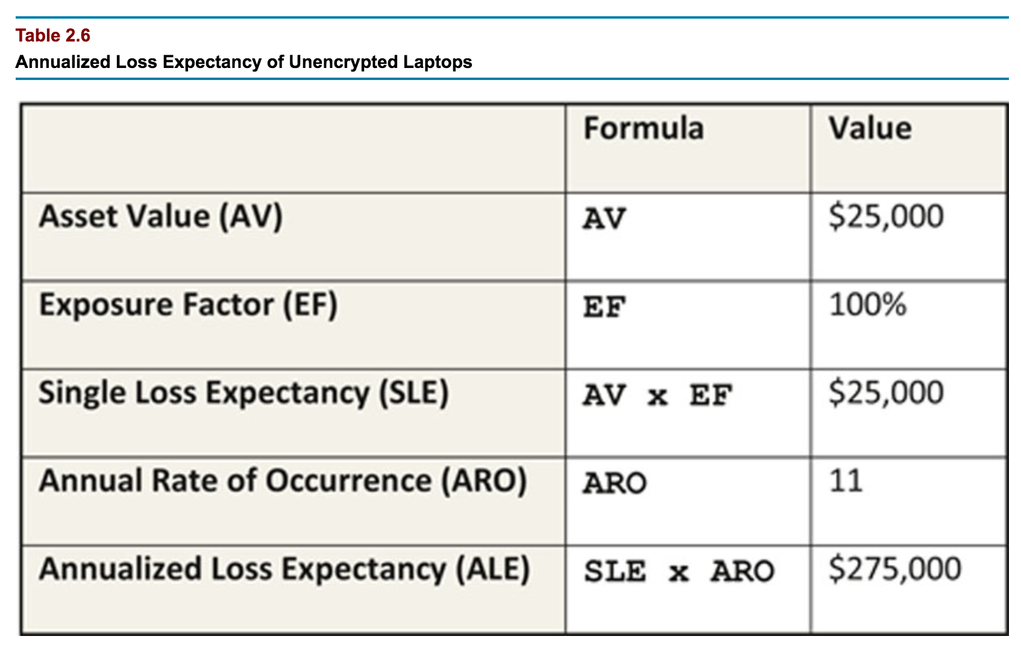
Risk Analysis
CISSP study guide, 3rd Edition. Conrad, Misenar, and Feldman

Slide 27
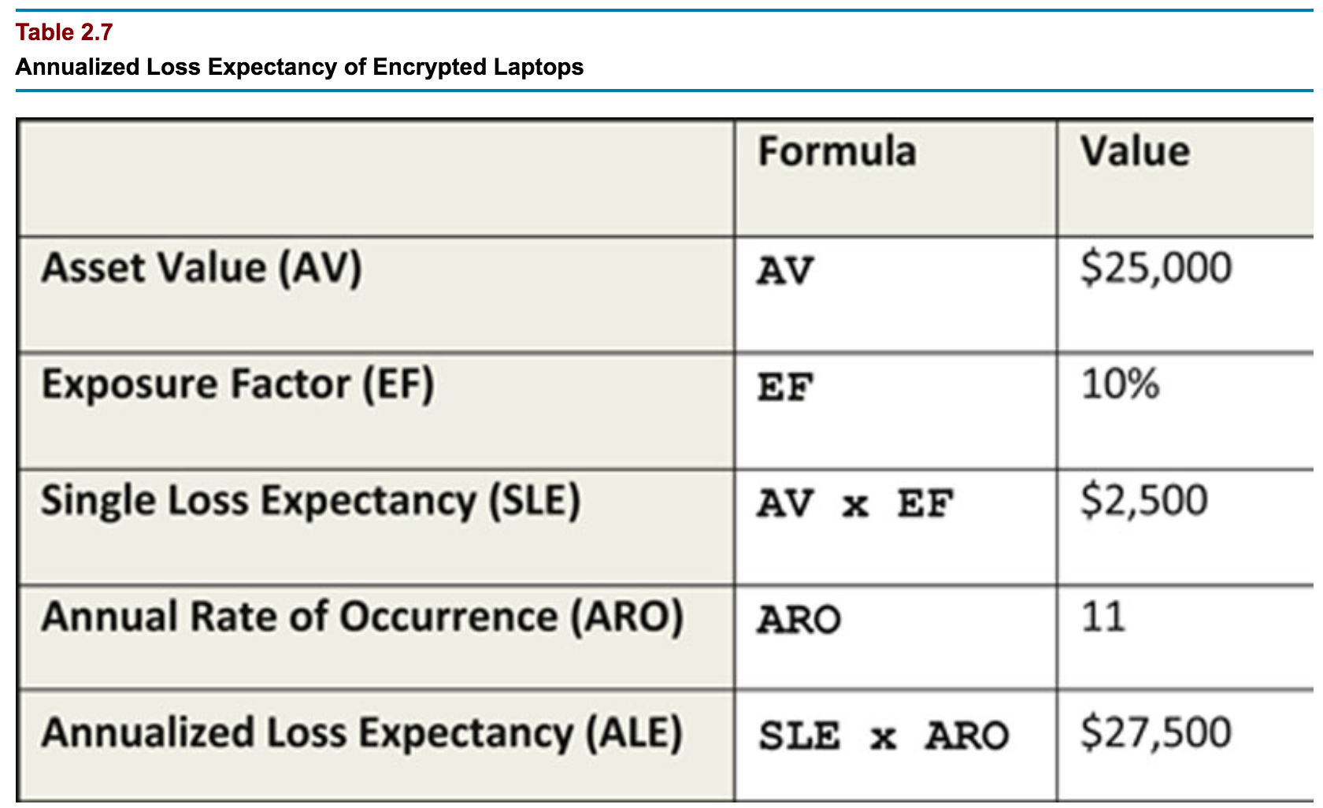
Risk Analysis
CISSP study guide, 3rd Edition. Conrad, Misenar, and Feldman

Slide 28
Risk Analysis
Choices:
Accept the risk.
This is after proper evaluation and estimation!
Mitigate the risk.
E.g. Laptop example. Risk still exists, but reduced.
Transfer the risk.
Purchase insurance from risk analysis experts.
Risk avoidance.
Before beginning a new project, you estimate risk and determine whether to avoid the project altogether.
Example: offer repeat customers to store their credit card numbers?

Slide 29
Incident Response
NIST special 800-61: Computer Security Incident Handling Guide.

Slide 30
Incident Response
Examples of incidents
Botnet causes webserver to crash.
Employees are tricked into opening an attachment containing malware.
Indication of ransomed information.

Slide 31
Incident Response
Preparation
Writing Policies
Delegation of roles and responsibilities
Reporting requirements (internal and external)
Authorizations (e.g. to confiscate hardware)
Plans
Organizational approach,
Methods for communication
Prepared hardware and software for analysis and mitigation. (E.g. sniffers, forensic software…)
Prepared documents: network diagrams, baselines, hashes of critical files, etc.
Standard operating procedures.

Slide 32
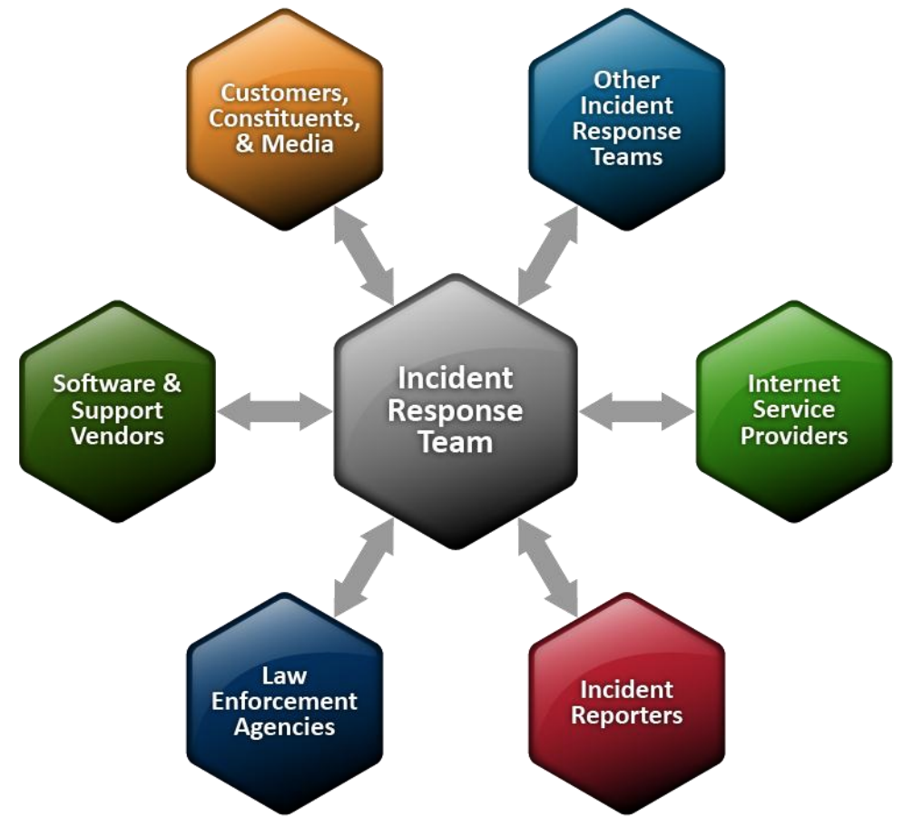
Incident Response
NIST special 800-61

Slide 33
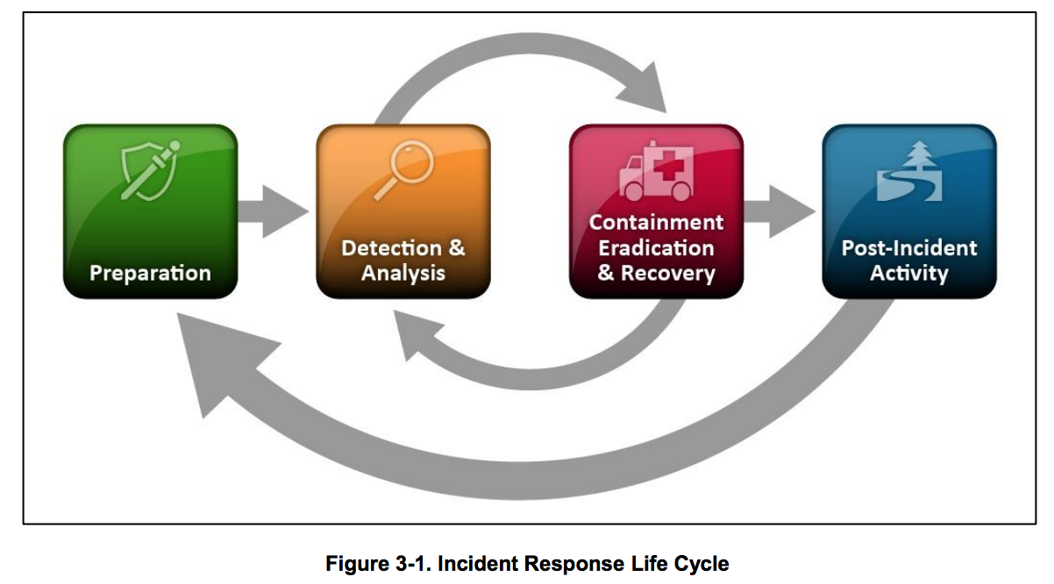
Incident Response
Detection and Analysis: attack vectors
Removable media (e.g. USB sticks).
Attrition: DDOS, brute force against passwds…
Web: X-site scripting, browser exploits...
Email
Impersonation
Improper usage
Loss or theft

Slide 34
Incident Response
Detection and Analysis:
Precursors: sign of a future incident
Rare.
Examples: web server log shows vulnerability scanner was in use. Announcement of a new vulnerability.
Indicators
Too common!
Examples: IDS or antivirus alert, admin sees suspicious filenames, application log lists many failed logins
More examples: file integrity checking, network logs, OS logs, users notice weird behavior.

Slide 35
Incident Response
Detection and Analysis:
Indicators have to be validated.
Once validated
Start recording facts about the incident:
current status,
indicators,
other related incidents,
Actions taken,
Impact assessments,
Lists of evidence…

Slide 36
Incident Response
Detection and Analysis: prioritizing
“… perhaps the most critical decision point in the incident handling process.”
Functional impact of the incident
Information impact of the incident
Recoverability from the incident
If it is too severe to allow recovery, it might not be worth wasting resources!

Slide 37
Incident Response
Detection and Analysis: reporting
CIO
Head of information security
Local information security officer
Other incident response teams within the organization
External incident response teams (if appropriate)
System owner
Human resources (for cases involving employees, such as harassment through email)
Public affairs (for incidents that may generate publicity)
Legal department (for incidents with potential legal ramifications)
US-CERT (required for Federal agencies and systems operated on behalf of the Federal government;
see Section 2.3.4.3)
Law enforcement (if appropriate)

Slide 38
Incident Response
Containment
Involves important decision making, such as whether to disconnect a resource
Have a strategy in place for each type of incident.
Considerations:
Impact of the strategy on business operations
Need for evidence preservation
Cost of implementing the strategy
Effectiveness of the strategy
Subtleties arise:
disconnecting some malware from the network might cause it start deleting or encrypting files.
Leaving it connected might allow it to spread.

Slide 39
Incident Response
Eradication and Recovery:
Typically OS and application specific.
Involves such things as:
identifying affected hosts and restoring to prior state,
Installing patches,
Restoring systems to backup,
Tightening perimeter security.
Phased approach:
Early phases focus on quick, high value changes to prevent repeat of the incident.
Later phases focus on longer-term efforts to improve security.

Slide 40
Incident Response
Post-Incident Activity:
Lessons learned meeting.
Help determine how to improve in the next incident,
produce data, e.g.
hours spent and cost of recovery.
Measure how closely the response fit the plan.
Determine whether the incident was sufficiently identified in precursors and indicators.
Determine if damage was done prior to identification.

Slide 41
Business Continuity and Disaster Recovery

Slide 42
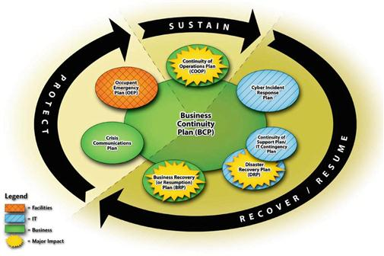
NIST SP 800-34 Contingency Planning Guide for Information Technology Systems.

Slide 43
Business continuity plan
Goal is to ensure that operation continues through and after a disaster event.
Focus is on the business as a whole, not just IT, and that the critical functions and services continue to operate.
In contrast: DRP is tactical rather than strategic, and IT focused. It is a part of BCP, but they are often confused.

Slide 44
BCP/DRP
Disaster types:
Natural (earthquakes, tornados, hurricanes)
Human (intentional, unintentional)
Strikes, warfare, errors, personnel shortages, financially motivated crime…
Environmental (equipment failure, power surge, software flaws)

Slide 45
DRP
Respond: quickly assess damage, and declare.
Activate team
Communicate
Assess
Reconstitute, both at new temporary site, and begin recovery at original site.

Slide 46
Developing a BCP
Project Initiation
Scope the Project
Business Impact Analysis
Identify Preventive Controls
Recovery Strategy
Plan Design and Development
Implementation, Training, and Testing
BCP/DRP Maintenance2
NIST 800-34

Slide 47
Developing a BCP
Project Initiation
Scope the Project
Business Impact Analysis
Identify Preventive Controls
Recovery Strategy
Plan Design and Development
Implementation, Training, and Testing
BCP/DRP Maintenance2
NIST 800-34

Slide 48
Developing a BCP
Business Impact Analysis
“Enables [characterization of] the system components, supported mission/business processes, and interdependencies.”
Allows characterizing the consequences of a disruption.
Main goal: determine maximum tolerable downtime.

Slide 49
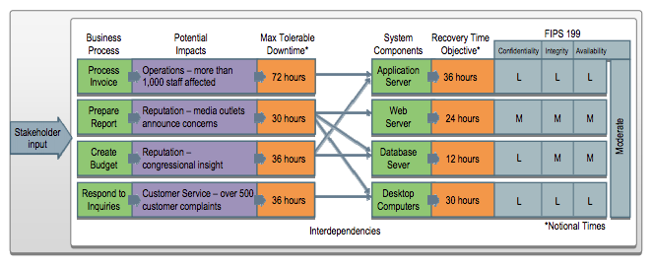
Developing a BCP
NIST 800-34

Slide 50
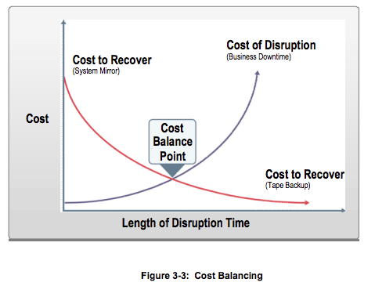
Developing a BCP
NIST 800-34

Slide 51
Developing a BCP/DRP
Recovery:
Redundant site: seamless, live data backups.
Hot site: has the hardware in place, raised floors, power, computer peripherals, full configurations, live data. Allows resumption of critical services in hours or even minutes.
Warm site: has hardware and connectivity, but needs to configure state from backup.
Cold Site: no available hardware or backup data. Very cheap, but could take weeks to setup.
Reciprocal Agreement and mobile sites.

Slide 52
Security Testing

Slide 53
Penetration Testing
Hacker that is paid to test the system to find vulnerabilities.
Planning
Reconnaissance
Scanning (also called enumeration)
Vulnerability assessment
Exploitation
Reporting

Slide 54
Vulnerability Testing
Software that looks for a pre-specified list of vulnerabilities.
System misconfigurations
Outdated or unpatched software
Doesn’t help determine risk, since it doesn’t help evaluate the threat of an exploit.
Still useful!

Slide 55
Vulnerability Testing
Try to exploit detected vulnerabilities, for example:
Buffer overflow
Heap overflow
SQL injection
Code injection
Cross-site scripting
Metasploit is a framework that allows to test attacks

Slide 56
Alternatives
Tools Features | Core Impact | Immunity Canvas | SecurityForest | Metasploit
License | 25.000$ Open-source (but some libraries are only in binaries) | 1.450$ Open source 3 months of updates and support | Free and Open-source | Free and Open-source
Number of Exploits | - | more of 150 | ~2500 (at February 2005) | 191 (at October 2007)
Updates | Frequently (weekly) | Frequently (average 4 exploit every month) | Occasionally (last updates in 2005) | Occasionally (last updates on October 2007)
Platform | Only Windows | Independent | Only Windows | Independent
Program Language | Python | Python | Perl for framework, many others languages for exploits (C,Perl,Python,Ruby,Shell,...) | Ruby, C, Assembler
Advantages | Report system / Integrationwith vulnerability assessment tools | 0-day payload | Number of pre-compiled exploits (see ExploitationTree) | Free / IDS-IPS evasion / support to write exploits and large used in security community

Slide 57
Security Audits
Certain activities require compliance with published security standard.
Example: Payment Card Industry Data Security Standard.
Requires firewalls, specific access controls, and wireless encryption.
An auditor will verify that an organization meets the specified standard.

Slide 58
Security Assessments
Broader view than a penetration test.
Policies, procedures, and other administrative controls
Assessing the real world-effectiveness of administrative controls
Change management
Architectural review
Penetration tests
Vulnerability assessments
Security audits

Slide 59
Log Reviews
Network Security Software/Hardware:
Antivirus logs
IDS/IPS logs
Remote Access Software (such as VPN logs)
Web proxy
Vulnerability management
Authentication servers
Routers and firewalls
Operating System:
System events
Audit records
Applications
Client requests and server responses
Usage information
Significant operational actions
NIST Special Publication 800-92

Slide 60
Log reviews
Centralized Logging
Enables better IDS
Makes it easier to verify the quality of the logging.
Syslog is the most common tool for unix-based operating systems.
By default, uses UDP (transmission errors)
By default, uses no encryption.
Log retention policies
Shouldn’t overburden, outweighing the utility.
Must comply with regulatory and legal requirements.

Slide 61
Software testing
Static testing vs. dynamic testing.
Both are good: each might catch problems the other doesn’t.
Unit Testing: Low-level tests of software components, such as functions, procedures or objects
Installation Testing: Testing software as it is installed and first operated
Integration Testing: Testing multiple software components as they are combined into a working system. Subsets may be tested, or Big Bang integration testing tests all integrated software components
Regression Testing: Testing software after updates, modifications, or patches
Acceptance Testing: testing to ensure the software meets the customer’s operational requirements. When this testing is done directly by the customer, it is called User Acceptance Testing.
CISSP study guide, 3rd Edition. Conrad, Misenar, and Feldman

Slide 62
Software testing
Fuzzing: particular type of dynamic testing. Black box (no look at the code).
Use random inputs: as environment variables, command line arguments and program inputs.
Looking for crashes, or other bad behavior.
Often a sign of an overflow vulnerability, but can also find other problems.
Test coverage analysis:
Attempt to identify which lines of code were not “flexed” or analyzed in the testing.
Interface testing: testing the software from various browsers, hardware, while running other related software, etc.
CISSP study guide, 3rd Edition. Conrad, Misenar, and Feldman

Slide 63
Assessing acquired software
Know your needs before evaluating the software. Don’t be sold on a new need by the software owner/developer.
For commercial off-the-shelf software:
Don’t immediately trust claims
Have a “competition” and see which meets needs.
Use 3rd party analysis of competing products.
Consider how it fits with other software currently in use.
Consider cost of maintaining and monitoring it.
What if they go out of business? How easy is it to continue supporting in-house, or 3rd party?
Custom built software
Service level agreements are crucial
Make sure they are contractually obligated to consider the security requirements that you have in mind.

Slide 64
Forensics
Traditional approach: cut the power, preserve the “crime scene”.
Concern was that malware might detect the forensic activity and alter it’s behavior.
Malware that resides entirely in RAM make this approach less tenable.
“live forensics”:
Take a binary image of memory.
Gather information about running processes and network data.

Slide 65
Forensics
Media analysis:
Take binary image of the media (hard drive, USB drive, etc.)
As opposed to backups, which typically copy the allocated portions of memory, ignoring the rest.
4 types of space captured in binary image:
Allocated space
Unallocated space: might have been freed up, but not wiped.
Slack space: space is allocated in fixed block sizes. If the last portion of the block is not used by the file, it might contain old data.
Bad blocks: blocks that are physically damaged are marked as “bad” and ignored by the OS. Malware can mark blocks as bad in order to hide information there.

Slide 66
Forensics
Network forensics:
Exploits might never be written to disk, but the evidence could still be found in the network trace.
Process is similar to network based IDS, but with a focus on legal issues.
Emails, web history, file transfers, can all be reconstructed from network equipment, providing a more complete view of how an incident occurred.
Forensic software analysis:
Reverse engineer malware binary to learn about the attacker.
Makes use of disassemblers, debuggers, and virtualization.

