Slide 1
Programmers Ain’t Mathematicians and Neither Are Testers
Jeff Offutt
Software Engineering
George Mason University
Fairfax, VA USA
www.cs.gmu.edu/~offutt/
offutt@gmu.edu

Slide 2
ICFEM – 10 Year Anniversary
ICFEM 1 – 1997 in Hiroshima
Florida, Macau, Manchester, Seattle, Singapore, Shanghai, York, Brisbane, Hiroshima
The challenge is to scale up formal methods and integrate them into engineering development processes ... bring together those interested in the application of formal engineering methods to computer systems.
Great papers on engineering of formal methods
Growth of this conference has proved it to be an undeniable success

Slide 3
Why Formal Methods?
NASA’s Mars lander, September 1999, crashed due to a units integration fault—over $50 million US !
Huge losses due to web application failures
Financial services : $6.5 million per hour
Credit card sales applications : $2.4 million per hour
In Dec 2006, amazon.com’s BOGO offer turned into a double discount
Symantec says that most security vulnerabilities are due to faulty software
Formal methods could solve most of these problems
World-wide monetary loss due to poor software is staggering

Slide 4
Evolving From Formal Methods
BS in Mathematics
I fell in love with abstract algebra and programming
to … MS / PhD in Computer Science
I was shocked at how hard it was to build bad software – and wondered how to make it easier to build good software
to … Research in Software Engineering
Applying math to build high quality software
Not just efficiency, but reliability, maintainability, usability, security, …

Slide 5
Specification-Based Testing (SBT)
In the early 1990s I got interested in algebraic specifications
Taught in several courses
Wrote an NSF proposal on spec-based testing
Eventually concluded :
Very hard to scale algebraic specs beyond stacks and queues
Nobody in industry would use them
Later Paul Ammann and I did some work on generating tests from Z specifications
But I had to re-learn the syntax every time I saw a Z spec
The strongest part of that paper was in input space partitioning–in particular, the base choice criteria
This led to an interest in state-based specifications

Slide 6
State-Based Specifications
In the mid-1990s I started looking at test criteria on state-based specifications
Steve Miller and Dave Statezni from Rockwell-Collins asked for help
They had specifications in SCR
The U.S. Federal Aviation Administration (FAA) required them to apply MCDC to code so I started there
Multiple Condition Decision Coverage (MCDC) : MCDC requires that each condition in a decision be shown by execution to independently affect the outcome of the decision.
— Chilenski & Miller, RTCA-DO-178B

Slide 7
MCDC Problems
What does “independently effect the outcome” mean ?
What does “show by execution” mean ?
In p = a ∨ (b ∧ c), a determines p when (bc) = (tt), (tf), or (ft)
Which one ?
Must b and c be the same when a=t and when a=f ?
What if p has the same value when a=t and when a=f ?
Full Predicate Coverage (FP) : For each clause c in p, c must control the value of p (c and p are “correlated”)
— Offutt, Xiong and Liu, ICECCS, 1999
FP does not require the predicate to have different values

Slide 8
Active Clause Coverage
Later Paul Ammann and I revisited this controversy
Active Clause Coverage (ACC) : For each clause c in p, the other clauses have values so that c determines p. and p must be true for one value of c and false for the other
— Ammann and Offutt, ISSRE 2003
Two variations :
Restricted Active Clause Coverage (RACC) : The values for the other clauses must be the same with both values for c
Correlated Active Clause Coverage (CACC) : The values for the other clauses can be different with both values for c
Clearer terminology, no ambiguity

Slide 9
SPC & Model-Based Testing
In 1999 I adapted full predicate to UML statecharts for Rockwell-Collins
Now the field of model-based testing is quite active with dozens of papers every year
In my many visits to Rockwell-Collins, I realized
The engineers hated MCDC, FP, and the FAA requirements
They often took shortcuts
Hand computations were incredibly expensive and error-prone
Programmers ain’t mathematicians !
We cannot make programmers use formal methods
What are the underlying differences ?

Slide 10
Math, CS, Software Engineering
We got into trouble because Computer Science was largely created by Mathematicians
Seeking perfect answers, not engineering solutions
And with the name “computer science” … we tried too hard to be “scientists”
Remember the original purpose of formal methods?
We naively thought we could “formally prove” programs to be “correct”
Just like a geometry theorem …
Science, Math and Computing are related …

Slide 11
Goals of Science and Engineering
Behaviors
observe
achieve
Science
Engineering
find and
describe
design and
develop
Structures

Slide 12
Computing is Different
Behaviors
Behaviors
observe
achieve
Science
Engineering
find and
describe
design and
develop
achieve
Structures
Computing
design and
develop
imagine
model
Structures

Slide 13
The Changing Face of Computing
1982
80% of people in IT industry were programmers
CS curricula were based on the research interests of the faculty (automata, OS, compilers, AI, … )
2008
< 20% of people in IT are programmers
Industry and research interests have diverged
CS departments struggle to get people to teach compilers
Curricula have changed very little – added networks and graphics

Slide 14
Historical Perspective
Physics
Biology
Math
1800s
Chemistry
Mechanical
etc.
Civil
Physics
1900s
ECE
etc.
Computer
Science
2000s
Computing
???

Slide 15
Possible Computing Fields (2020)
Software Engineering
programming, algorithms,
analysis, design
programming,
algorithms, creativity
Artificial Intelligence
Games & Graphics
math, programming,
algorithms
Computer Science
theory, algorithms,
programming
Information Technology
Information Systems
no math
no programming
Networking
analysis, design,
programming
analysis, problem
solving, design

Slide 16
Evolution of Formalism in Software Engineering
1970s : Attempts to “prove” programs work “correctly”
The proof always comes back false –then what ?
What is “correctness” ? Is a train correct ?
Proofs are social processes, not automated … nobody wants to read proofs of programs
1980s—1990s : Formal specifications
Mathematical descriptions of behavior
Specification-based testing
1990s—2000s : Semi-formal modeling
Usually no formal semantics
Model-based testing

Slide 17
Key Difference
What software does
How software does it
Definitional
Procedural
Z
VDM
CSP
CCS HOL
LOTOS
SOFL
FSMs
PNs
Lisp
APL
C
Java
Statecharts
Crossing the “What / How” barrier is very hard !!

Slide 18
What Versus How
We’ve been trying for 30 years to cross this barrier !
Mathematicians think definitionally about what
Engineers think procedurally about how
MODULE main
#define false 0
#define true 1
VAR
x, y : boolean;
ASSIGN
init (x) := false;
init (y) := false;
next (x) := case
!x & y : true;
!y : true;
x : false;
true : x;
esac;
next (y) := case
x & !y : false;
x & y : y;
!x & y : false;
true : true;
esac;
FF
TT
TF
FT

Slide 19
What Can We Do ?
“Make” engineers use formal methods ?
We do not have that power …
and … they ain’t mathematicians …
Teach them formal methods are better ?
It’s been a hard sell for a very long time …
and … they ain’t mathematicians …
Give up ?
“if you can’t beat ‘em, join ‘em”
Infiltrate them …
They ain’t mathematicians
But they don’t need to be !!!

Slide 20
Three Approaches
Isolate
One mathematician supporting a group of engineers
An “enabler” to cross the barrier
Disguise
Refine the formal methods into engineering techniques
Hide the math in programming standards, frameworks or language features
Embed
Put the math into tools
Hide them in processes
All this science,
I don't understand
It's just my job,
5 days a week.
A rocket man!
– Elton John

Slide 21
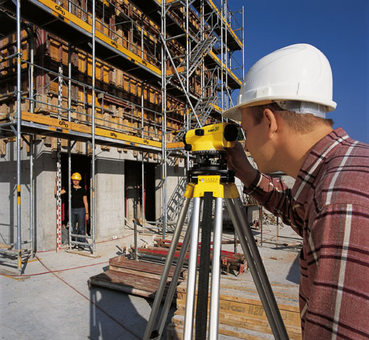
1. Isolate
Building construction takes a lot of math
Civil engineers eat math at every meal for four years in college
But in construction … one civil
engineer and hundreds of other
professionals …
And the theory part ?
Maybe one physicist for 1000
engineers !
Why should everyone learn
formal methods ?

Slide 22
1. Isolation in Software Testing
At George Mason, Paul Ammann and I have been teaching software testing to MS students for 20 years
Previous book (Beizer) went out of print in 2002
So we started writing our own
Introduction to Software Testing, Cambridge Press, 2008
Along the way, we completely inverted the way testing is taught …
Resulting in a completely different way to apply formal engineering methods to testing …

Slide 23
Types of Test Activities
Testing can be broken up into four general types of activities
Test Design
Test Automation
Test Execution
Test Evaluation
Each type of activity requires different skills, background knowledge, education and training
No reasonable software development organization uses the same people for requirements, design, implementation, integration and configuration control
1.a) Criteria-based
1.b) Human-based
Why do test organizations still use the same people for all four test activities??
This clearly wastes resources

Slide 24
Summary of Test Activities
1a. | Design | Design test values to satisfy engineering goals
 | Criteria | Requires knowledge of discrete math, programming and testing
1b. | Design | Design test values from domain knowledge and intuition
 | Human | Requires knowledge of domain, UI, testing
2. | Automation | Embed test values into executable scripts
 |  | Requires knowledge of scripting
3. | Execution | Run tests on the software and record the results
 |  | Requires very little knowledge
4. | Evaluation | Evaluate results of testing, report to developers
 |  | Requires domain knowledge
These four general test activities are quite different
It is a poor use of resources to use people inappropriately
Most test teams use the same people for ALL FOUR activities !!

Slide 25
Model-Driven Test Design – Steps
criterion
refine
refined requirements / test specs
model / structure
test requirements
generate
analysis
DESIGN
ABSTRACTION
LEVEL
IMPLEMENTATION
ABSTRACTION
LEVEL
software artifact
input values
evaluate
execute
automate
prefix
postfix
expected
pass / fail
test results
test scripts
test cases

Slide 26
MDTD – Activities
refined requirements / test specs
Here
be
math
model / structure
test requirements
Test Design
Test Design
DESIGN
ABSTRACTION
LEVEL
Raising our abstraction level makes
test design MUCH easier
IMPLEMENTATION
ABSTRACTION
LEVEL
software artifact
input values
Test Automation
Effective, efficient, isolation of formal engineering
pass / fail
test results
test scripts
test cases
Test Evaluation
Test Execution

Slide 27
1. Using MDTD to Isolate
This approach lets one mathematician do the math
Test design
Then testers and programmers can do their parts
Find values
Automate the tests
Run the tests
Evaluate the tests
Testers ain’t mathematicians !

Slide 28
Three Approaches
Isolate
One mathematician supporting a group of engineers
An “enabler” to cross the barrier
Disguise
Refine the formal methods into engineering techniques
Hide the math in programming standards, frameworks or language features
Embed
Put the math into tools
Hide them in processes
All this science,
I don't understand
It's just my job,
5 days a week.
A rocket man!
– Elton John

Slide 29
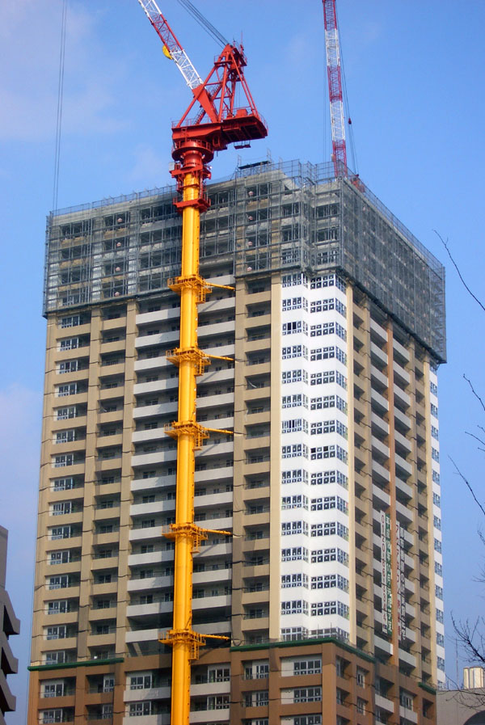
2. Disguise
Building construction uses many standards
They have “codes” for where door knobs go, how many electrical outlets to use, doors, …
Team foremen know the standards,
but workers often do not
Software engineering needs to
disguise formal methods into
engineering techniques &
processes
This is how design-by-contracts
started

Slide 30
2. Disguising in Programming
The first course in our MS in Software Engineering is Object-Oriented Design and Construction
We teach type theory, representation invariants, polymorphism theory, component specification, and refinement
All formal methods topics …
But the students think it’s a programming class !!!
Instead of teaching the math directly, we teach them proper design and programming techniques
The formalism is refined into practical programming guidelines
This is a math class … in disguise !

Slide 31
2. Stealthy Formal Methods Class
This stealthy approach is greatly helped by two books:
Liskov with Guttag, Program Development in Java
Bloch, Effective Java
Liskov, of course, invented much of type theory
This book explains how to build OO classes and type hierarchies that are type-safe (among other things)
Bloch teaches how OO program components can safely interact without violating formal requirements
Students who later take a formal methods class are thrilled to see the theory behind the practice
Learning theory in front of practice is for mathematicians
Programmers ain’t mathematicians !

Slide 32
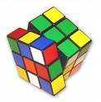
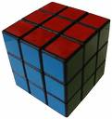
2. Disguising Abstract Algebra
In 1980, as a 3rd year math major, I took a class in Abstract Algebra
Group theory, rings, homomorphisms …
Fun stuff ! (for a mathematician)
Midway through, I discovered that abstract algebras can be used to represent the Rubik’s cube
And developed an algebra to solve it
Data structures are informal algebraic
groups
But well disguised !
Programmers ain’t mathematicians !

Slide 33
Three Approaches
Isolate
One mathematician supporting a group of engineers
An “enabler” to cross the barrier
Disguise
Refine the formal methods into engineering techniques
Hide the math in programming standards, frameworks or language features
Embed
Put the math into tools
Hide them in processes
All this science,
I don't understand
It's just my job,
5 days a week.
A rocket man!
– Elton John

Slide 34
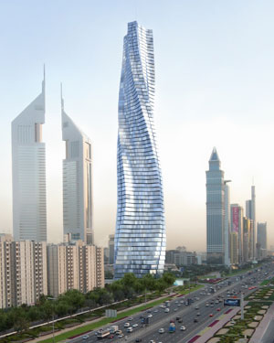
3. Embed
Building construction is starting to use pre-fabricated modular units
The units save time
They also allow the math to be
embedded in the units
Standards, stress, …
Software engineering needs to
embed formal methods in
languages, components, processes
Isn’t that what strong typing is ?

Slide 35
Data Structures and Frameworks
When I was a professional programmer, we built data structures out of pointers, records and arrays
Mistakes allowed structures to have invalid states
The formal specs, although not explicitly stated, were not always satisfied
Frameworks like the Java Collections embed the formal specs into software so programmers do not have to understand them
Programmers can now use data structures without knowing how to build them
The use of frameworks is expanding—very common now in web applications

Slide 36
Embedding Math in Testing Tools
In specification-based testing :
Each clause is tested separately when it determines the value of the predicate (CACC )
Determination :
Clause c_{i} in predicate p, the major clause, determines p if and only if values for the remaining minor clauses c_{j} are such that changing c_{i} changes the value of p
Boolean Derivatives :
p_{c}=true is p with every occurrence of c replaced by true
p_{c}=false is p with every occurrence of c replaced by false
To find minor clause values for c to determine the value, solve the following:
p_{c} = p_{c=true} ⊕ p_{c=false}

Slide 37
Embedding into Tools
p_{c} = p_{c=true} ⊕ p_{c=false}
p = a ∨ (b ∧ c)
p_{a} = p_{a=true} ⊕ p_{a=false}
= (true ∨ (b ∧ c)) ⊕ (false ∨ (b ∧ c))
= true ⊕ (b ∧ c)
= ¬ (b ∧ c)
= ¬ b ∨ ¬ c
This is not very difficult
But there is no reason for all testers to know this !
Embed this computation in a tool :
http://cs.gmu.edu:8080/offutt/coverage/LogicCoverage
Testers ain’t mathematicians !

Slide 38
Agenda for
Researchers
Teachers
Practitioners

Slide 39
Agenda for Researchers
Invent processes and techniques that isolate math so that only a few individuals need to use it
Discover engineering techniques, standards and frameworks that disguise the math
Develop more clever ways to embed the math into tools and processes
Empirically validate the benefits of formal methods
Industry doesn’t believe they help !
Do you know they help, or only believe ?

Slide 40
Agenda for Teachers
Teach classes to engineers that disguise the math
We must understand both sides
We need to become enablers
Ask ourselves when math is needed
And when it can be omitted (isolated, disguised, embedded)
Restructure our curricula so that we teach the needed math to a few
And don’t make the rest suffer

Slide 41
Agenda for Practitioners
Organize test and QA teams to make effective use of individual abilities
One math-head can support many testers
Think carefully about who should create formal models and how they interact with programmers
Encourage researchers to embed and isolate
We are very responsive to research grants …
Get involved in curricular design efforts through industrial advisory boards

Slide 42
Contact
Jeff Offutt
offutt@gmu.edu
http://cs.gmu.edu/~offutt/
Domo arigato gozai mashta

