Slide 1
Automatically Generating Test Data for Web Applications
Jeff Offutt
Professor, Software Engineering
George Mason University
Fairfax, VA USA
www.cs.gmu.edu/~offutt/
offutt@gmu.edu
Joint research with Blaine Donley, Xiaochen Du, Hong Huang, Zhenyi Jin, Jie Pan, Upsorn Praphamontripong, Ye Wu

Slide 2
OUTLINE
The Cost of Not Testing
Automatic Test Data Generators
Dynamic Domain Reduction
Input Validation Testing
Bypass Testing
Research to Practice
Summary

Slide 3
Testing in the 21st Century
Software defines behavior
  network routers, finance, switching networks, other infrastructure
Today’s software market :
  is much bigger
  is more competitive
  has more users
Embedded Control Applications
  airplanes, air traffic control
  spaceships
  watches
  ovens
  remote controllers
Agile processes put increased pressure on testers
  Programmers must unit test – with no training, education or tools !
  Tests are key to functional requirements – but who builds those tests ?
Industry is going through a revolution in what testing means to the success of software products
  PDAs
  memory seats
  DVD players
  garage door openers
  cell phones

Slide 4
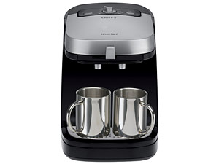

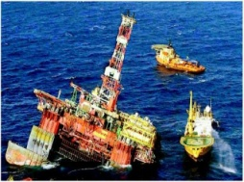
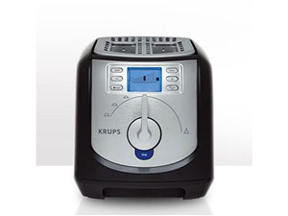

Software is a Skin that Surrounds Our Civilization
Quote due to Dr. Mark Harman

Slide 5

Airbus 319 Safety Critical Software Control
Loss of autopilot
Loss of most flight deck lighting and intercom
Loss of both the commander’s and the co‑pilot’s primary flight and navigation displays !

Slide 6
Costly Software Failures
2002 : NIST report, “The Economic Impacts of Inadequate Infrastructure for Software Testing”
  Inadequate software testing costs the US alone between $22 and $59 billion USD annually
  Better testing could cut this amount in half
2003 : Northeast power blackout, failure in alarm software
2006 : Amazon’s BOGO offer became a double discount
2007 : Symantec says that most security vulnerabilities are now due to faulty software
Huge losses due to web application failures
  Financial services : $6.5 million per hour (just in USA!)
  Credit card sales applications : $2.4 million per hour (in USA)
World-wide monetary loss due to poor software is staggering

Slide 7
Model-Driven Test Design – Steps
criterion
refine
refined requirements / test specs
model / structure
test requirements
generate
analysis
test requirements
human based
DESIGN
ABSTRACTION
LEVEL
IMPLEMENTATION
ABSTRACTION
LEVEL
software artifact
input values
feedback
evaluate
execute
automate
prefix
postfix
expected
pass / fail
test results
test scripts
test cases

Slide 8
Model-Driven Test Design – Activities
refined requirements / test specs
model / structure
test requirements
Test Design
DESIGN
ABSTRACTION
LEVEL
Raising our abstraction level makes
test design MUCH easier
IMPLEMENTATION
ABSTRACTION
LEVEL
software artifact
input values
Test Automation
pass / fail
test results
test scripts
test cases
Test Evaluation
Test Execution

Slide 9
Cost Of Late Testing
60
Assume $1000 unit cost, per fault, 100 faults
$250K
50
40
$35K
$360K
$150K
Fault origin (%)
Fault detection (%)
Unit cost (X)
30
$18K
$100K
20
$20K
$13K
10
$6K
$100K
$50K
0
Total Savings
$190K
Requirements
Design
Prog / Unit Test
Integration Test
System Test
Production
Software Engineering Institute; Carnegie Mellon University; Handbook CMU/SEI-96-HB-002
Notes:
28-Oct-2010, at GTAC, added the animation to demonstrate increasing the number of faults found early, thereby decreasing the number of faults found late, and finally saving money. Lots of it! This animation is fairly complicated … must practice first!!

Slide 10
How to Improve Testing ?
Testers need more and better software tools
Testers need to adopt practices and techniques that lead to more efficient and effective testing
  More education
  Different management organizational strategies
Testing / QA teams need more technical expertise
  Developer expertise has been increasing dramatically
Testing / QA teams need to specialize more
  This same trend happened for development in the 1990s
Reduce the manual expense of test design

Slide 11
OUTLINE
The Cost of Not Testing
Automatic Test Data Generators
Dynamic Domain Reduction
Input Validation Testing
Bypass Testing
Research to Practice
Summary

Slide 12
Quality of Industry Tools
My student recently evaluated three industrial automatic unit test data generators
  Jcrasher, TestGen, JUB
  Generate tests for Java classes
  Evaluated on the basis of mutants killed
Compared with two test criteria
  Random test generation (by hand)
  Edge coverage criterion (by hand)
Eight Java classes
  61 methods, 534 LOC, 1070 mutants (muJava)
— Shuang Wang and Jeff Offutt, Comparison of Unit-Level Automated Test Generation Tools, Mutation 2009

Slide 13
Unit Level ATDG Results
These tools essentially generate random values !

Slide 14
Quality of Criteria-Based Tests
Two other students recently compared four test criteria
  Edge-pair, All-uses, Prime path, Mutation
  Generated tests for Java classes
  Evaluated on the basis of finding hand-seeded faults
Twenty-nine Java packages
  51 classes, 174 methods, 2909 LOC
Eighty-eight hand-generated faults
— Nan Li, Upsorn Praphamontripong and Jeff Offutt, An Experimental Comparison of Four Unit Test Criteria: Mutation, Edge-Pair, All-uses and Prime Path Coverage, Mutation 2009

Slide 15
Criteria-Based Test Results
Researchers have invented very powerful techniques

Slide 16
Industry and Research Tool Gap
We cannot compare these two studies directly
However, we can summarize their conclusions :
  Industrial test data generators are ineffective
  Edge coverage is much better than the tests the tools generated
  Edge coverage is by far the weakest criterion
Biggest challenge was hand generation of tests
Software companies need to test better
Luckily, we have lots of room for improvement !

Slide 17
OUTLINE
The Cost of Not Testing
Automatic Test Data Generators
Dynamic Domain Reduction
Input Validation Testing
Bypass Testing
Research to Practice
Summary

Slide 18
Automatic Test Data Generation
ATDG tries to create effective test input values
  Values must match syntactic input requirements
  Values must satisfy semantic goals
The general problem is formally unsolvable
Syntax depends on the test level
  System : Create inputs based on user-level interaction
  Unit : Create inputs for method parameters and non-local variables
Semantic goals vary
  Random values
  Special values, invalid values
  Satisfy test criteria
I will start by considering test criteria applied to program units

Slide 19
Unit Level ATDG Origins
Late ’70s, early ’80s†
  Fortran and Pascal functions
  Symbolic execution to create constraints and LP-like solvers to find values
10-15 line functions, algorithms often failed at statement coverage
Early ’90s††
  Heuristics for solving constraints
  Revised algorithms for symbolic evaluation
Larger functions, edge coverage, >90% data flow, > 80% mutation
Mid to late ’90s†††
  Dynamic symbolic evaluation (concolic)
  Dynamic domain reduction algorithm for solving constraints
Handled loops, arrays, pointers, > 90% mutation scores
Current : Search-based procedures
†
Boyer, Elpas, and Levitt. Select-a formal system for testing and debugging programs by symbolic execution. SIGPLAN Notices, 10(6), June 1975
Clarke. A system to generate test data and symbolically execute programs. TSE, 2(3):215-222, September 1976
Ramamoorthy, Ho, and Chen. On the automated generation of program test data. TSE, 2(4):293-300, December 1976
Howden. Symbolic testing and the DISSECT symbolic evaluation system. TSE, 3(4), July 1977
Darringer and King. Applications of symbolic execution to program testing. IEEE Computer, 11(4), April 1978
††
Korel. Automated software test data generation. TSE, 16(8):870-879, August 1990
DeMillo and Offutt. Constraint-based automatic test data generation. TSE, 17(9):900-910, September 1991
†††
Korel. Dynamic method for software test data generation. STVR, Verification, and Reliability, 2(4):203-213, 1992
Jeff Offutt, Zhenyi Jin and Jie Pan. The Dynamic Domain Reduction Approach to Test Data Generation. SP&E, 29(2):167-193, January 1999

Slide 20
Dynamic Domain Reduction
Previous techniques generated complete systems of constraints to satisfy test requirements
  Memory requirements blow up quickly
DDR does its work “on the fly”
  Defines an initial symbolic domain for each input variable
  Picks a test path through the program
  Symbolically evaluates the path, reducing the input domains at each branch
  Evaluates expressions with domain-symbolic algorithms
  After walking the path, values in the input variables’ domains ensure execution of the path
  If a domain is empty, the path is re-evaluated with different decisions at branches

Slide 21
DDR Example
mid = z
Initial Domains
x: < -10 .. 10 >
y: < -10 .. 10 >
z: < -10 .. 10 >
Test Path
[ 1 2 3 5 10 ]
1
y >= z
y < z
1. Edge (1, 2)
y < z
split point is 0
x: < -10 .. 10 >
y: < -10 .. 0 >
z: < 1 .. 10 >
6
2
x > y
x <= y
x >= y
x >= y
mid = y
7
mid = y
8
3
4
x < z
2. Edge (2, 3)
x >= y
split point is -5
x: < -5 .. 10 >
y: < -10 .. -5 >
z: < 1 .. 10 >
x > z
3. Edge (3, 5)
x < z
split point is 2
x: < -5 .. 2 >
y: < -10 .. -5 >
z: < 3 .. 10 >
9
5
mid = x
mid = x
10
Any values from the domains for x, y and z will execute test path [ 1 2 3 5 10 ]
For example : (x = 0, y = -10, z = 8)

Slide 22
ATDG Adoption
These algorithms are very complicated
  But very powerful
Four companies have attempted to build commercial tools based on these or similar algorithms
  Two failed and only generate random values
  Agitar created Agitator, which uses algorithms similar to DDR …
  Agitator is now owned by McCabe software
  Pex at MicroSoft is also similar
Search-based procedures are easier but less effective
A major question is how to solve ATDG beyond the unit testing level ?
  For example … web applications ?

Slide 23
OUTLINE
The Cost of Not Testing
Automatic Test Data Generators
Dynamic Domain Reduction
Input Validation Testing
Bypass Testing
Research to Practice
Summary

Slide 24
Validating Inputs
Input Validation
Deciding if input values can be processed by the software
Before starting to process inputs, wisely written programs check that the inputs are valid
How should a program recognize invalid inputs ?
What should a program do with invalid inputs ?
It is easy to write input validators – but also easy to make mistakes !

Slide 25
Representing Input Domains
Goal domains are often irregular
Goal domain for credit cards†
  First digit is the Major Industry Identifier
  First 6 digits and length specify the issuer
  Final digit is a “check digit”
  Other digits identify a specific account
Common specified domain
  First digit is in { 3, 4, 5, 6 } (travel and banking)
  Length is between 13 and 16
Common implemented domain
  All digits are numeric
All digits are numeric
† More details are on : http://www.merriampark.com/anatomycc.htm

Slide 26
Representing Input Domains
Desired inputs (goal domain)
Described inputs (specified domain)
This region is a rich source of software errors …
… and security vulnerabilities !!!
Accepted inputs (implemented domain)

Slide 27
OUTLINE
The Cost of Not Testing
Automatic Test Data Generators
Dynamic Domain Reduction
Input Validation Testing
Bypass Testing
Research to Practice
Summary

Slide 28



Web Application Input Validation
Bad Data
Corrupts data base
Crashes server
Security violations
Check data
Check data
Sensitive Data
Client
Server
Malicious Data
Can “bypass” data checking

Slide 29
Bypass Testing
Web apps often validate on the client (with JS)
Users can “bypass” the client-side constraint enforcement by skipping the JavaScript
Bypass testing constructs tests to intentionally violate validation constraints
  Eases test automation
  Validates input validation
  Checks robustness
  Evaluates security
Case study on commercial web applications ...
— Offutt, Wu, Du and Huang, Bypass Testing of Web Applications, ISSRE 2004

Slide 30
Bypass Testing
Analyze the visible input restrictions
  Types of HTML tags and attributes
  JavaScript checks
Model these as constraints on the inputs
Design tests (automatically!) that violate the constraints
  Specific mutation-like rules for violating constraints
  Tuning for generating more or fewer tests
Encode the tests into a test automation framework that bypasses the client side checks

Slide 31
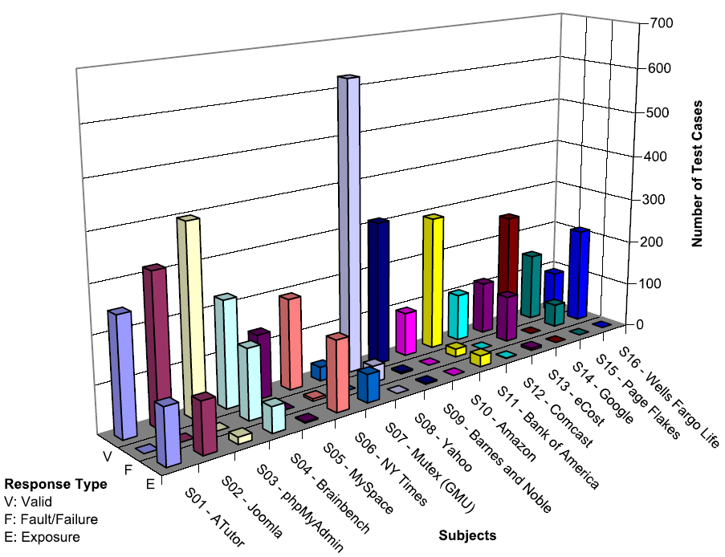
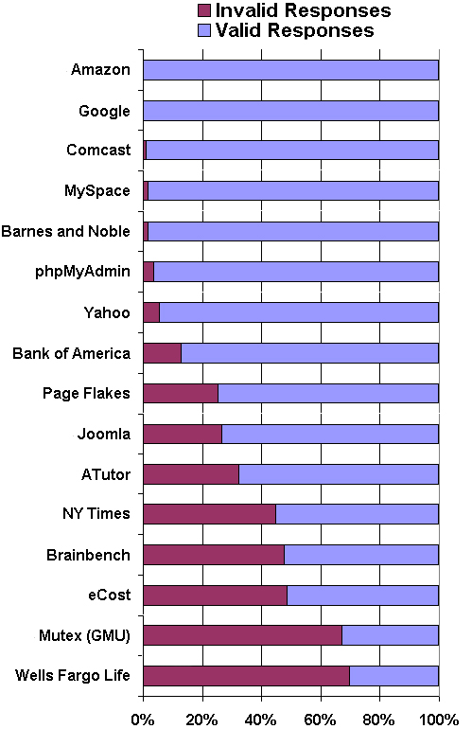
Bypass Testing Results
v
— Vasileios Papadimitriou. Masters thesis, Automating Bypass Testing for Web Applications, GMU 2006

Slide 32
Theory to Practice—Bypass Testing
Six screens tested from “production ready” software
Tests are invalid inputs – exceptions are expected
Effects on back-end were not checked
Web Screen | Tests | Failing Tests | Unique Failures
Points of Contact | 42 | 23 | 12
Time Profile | 53 | 23 | 23
Notification Profile | 34 | 12 | 6
Notification Filter | 26 | 16 | 7
Change PIN | 5 | 1 | 1
Create Account | 24 | 17 | 14
TOTAL | 184 | 92 | 63
33% “efficiency” rate is spectacular!
— Offutt, Wang and Ordille, An Industrial Case Study of Bypass Testing on Web Applications, ICST 2008

Slide 33
OUTLINE
The Cost of Not Testing
Automatic Test Data Generators
Dynamic Domain Reduction
Input Validation Testing
Bypass Testing
Research to Practice
Summary

Slide 34
Four Roadblocks to Adoption
Lack of test education
Necessity to change process
Usability of tools
Weak and ineffective tools
Bill Gates says half of MS engineers are testers, programmers spend half their time testing
Patrick Copeland says Google software engineers spend half their time unit testing
Number of undergrad CS programs in US that require testing ?
0
Number of MS CS programs in US that require testing ?
0
Number of undergrad testing classes in the US ?
~30
Adoption of many test techniques and tools require changes in development process
This is very expensive for large software companies
Many testing tools require the user to know the underlying theory to use them
Do we need to know how an internal combustion engine works to drive ?
Do we need to understand parsing and code generation to use a compiler ?
Most test tools don’t do much – but most users do not know it !
Few tools solve the key technical problem – generating test values automatically

Slide 35
Major Problems with ATDG
ATDG is not used because
  Existing tools only support weak ATDG or are extremely difficult to use
  Tools are difficult to develop
  Companies are unwilling to pay for tools
Researchers want theoretical perfection
  Testers expected to recognize infeasible test requirements
  Tools expected to satisfy all test requirements
This requires testers to become experts in ATDG !
Practical testers want easy-to-use engineering tools that make software better—not perfect tools !

Slide 36
Needed
ATDG tools must be integrated into development
Unit level ATDG tools must be designed for developers
ATDG tools must be easy to use
ATDG tools must give good tests
… but not perfect tests

Slide 37
A Practical Unit-Level ATDG Tool
Principles :
  Users must not be required to know testing
  Tool must ignore theoretical problems of completeness and infeasibility—an engineering approach
  Tool must integrate with IDE
  Must automate tests in JUnit
Process :
  After my class compiles cleanly, ATDG kicks in
  Generates tests, runs them, returns a list of results
  If any results are wrong, tester can start debugging

Slide 38
Practical System-Level ATDG Tool
Principles :
  Tests should be based on input domain description
  Input domain should be extracted from UI
  Tool must not need source
  Tests must be automated
  Humans must be allowed to provide values and tests
Process :
  Tests should be created as soon system is integrated
    ATDG part of integration tool
  Should support testers, allowing them to accept, override, or modify any parameters and test values

Slide 39
Test Design
Human-based test design uses knowledge of the software domain, knowledge of testing, and intuition to generate test values
Criteria-based test design uses engineering principles to generate test values that cover source, design, requirements, or other software artifact
A lot of test educators and researchers have taken an either / or approach – a competitive stance
To test effectively and efficiently, a test organization needs to combine both approaches !
A cooperative stance.

Slide 40
OUTLINE
The Cost of Not Testing
Automatic Test Data Generators
Dynamic Domain Reduction
Input Validation Testing
Bypass Testing
Research to Practice
Summary

Slide 41
Summary
Researchers strive for perfect solutions
Universities teach CS students to be theoretically strong—almost mathematicians
Industry needs usable, useful engineering tools
Industry needs engineers to develop software
ATDG is ready for technology transition
A successful tool should probably be free—open source

Slide 42

Contact
Jeff Offutt
offutt@gmu.edu
http://cs.gmu.edu/~offutt/

