Slide 1
Nobody cares about models, but everybody wants automation
Jeff Offutt
George Mason University
cs.gmu.edu/~offutt

Slide 2
A story about a young guy
Way back in the late 1990s, this young guy
scored a fun research project with Rockwell-Collins Aviation
Generating Test Cases From Requirements Specifications
Project goals:
Derive tests from formal specifications (Z, SCR)
Develop a tool to measure code coverage of spec-based tests
Using formal methods to derive test frames in category-partition testing, Ammann and Offutt, Computer Assurance Conference, 1994
Criteria for generating specification-based tests, Offutt, Xiong, and Liu, ICECCS 1999
Evaluation of Three Specification-based Testing Criteria, Abdurazik, Ammann, Ding, and Offutt, ICECCS 2000
Generating Test Data From State-based Specifications, Offutt, Liu, Abdurazik, and Ammann, STVR 2003

Slide 3
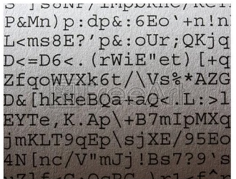
Story of a site visit
A two-day visit to Rockwell-Collins’ facility in Iowa
Met with research group, managers, project leads, developers, and testers
“We use formal specs!”
“See our specs?”
“We ain’t mathematicians.
We make formal spec diagrams after the software is finished.
But we use UML diagrams.”
“We read code to write tests”

Slide 4
Results from visit
Brainwave
We can design tests to cover (informal) graphs like UML
Managers didn’t believe me
Managers hated the idea
I lost the funding
But, published the first MBT papers—a new field!
Generating tests from UML specifications, Offutt and Abdurazik, UML 1999
(Finite state machines; edge coverage, predicate testing, edge-pair; 646 citations)
Using UML collaboration diagrams for static checking and test generation, Abdurazik and Offutt, UML 2000
Sort of …
An approach to program testing, J C Huang, ACM Computing Surveys, 1975 (edge coverage on flowcharts)

Slide 5
This was a long time ago
When software was based on an 1800s-style assembly line manufacturing process
Before the web changed everything

Slide 6
Engineering costs
Building any technology artifacts incurs costs
Design cost
Production costs
Distribution cost
Support costs
The relative amounts have changed over time
Before the industrial revolution, we used evolutionary design

Slide 7
Pre-industrial revolution
Design evolved over time, each new object better than the last
Low design costs
Very high production cost—weeks of labor
Low distribution cost—customers walked into the shop
Little or no support cost

Slide 8
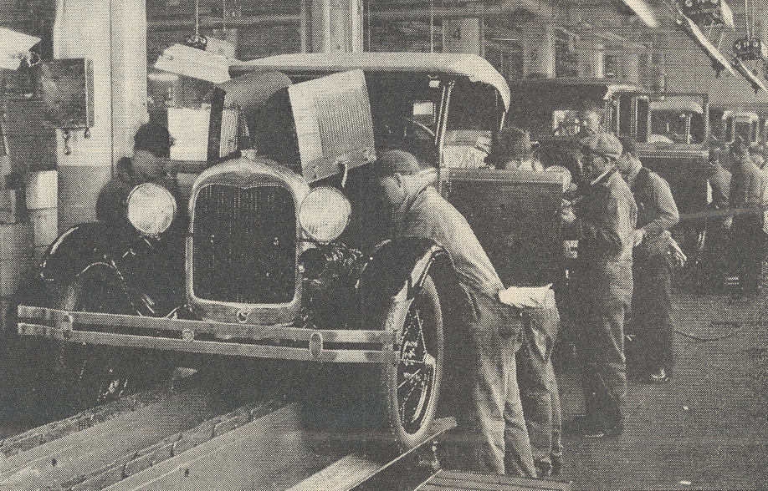
Assembly line
Manufacturing started to change this equation
The same design quickly put into thousands of products
Much higher design costs
Very low production cost
Distribution costs started to increase
Support costs increased—but were outsourced

Slide 9
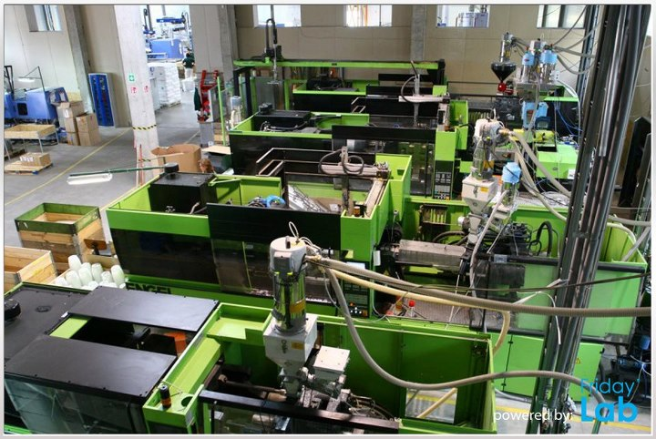
Automated manufacturing
Robots increased the speed and efficiency of production
Instead of training people, design costs now included creating expensive robots
Production costs continued to decline
Distribution costs continued to increase
Support costs continued to increase

Slide 10
Post-WWII global distribution
Design costs continued to increase
Production costs continued to decline
Distribution costs decreased dramatically
Support started to become “replace”

Slide 11
2000s : Free trade
Design is very expensive
production, distribution, & support are cheap
Manufacturing defeated evolutionary design !
Quantity over quality

Slide 12
Losing evolutionary design
Advantages
Products are very cheap
Quality is often low—designed to wear out fast
Instead of evolution …
we have replacement
And we have lost something truly wonderful
craftsmanship

Slide 13
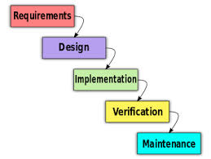
Assembly line software
1980s—1990s
Very high design costs
High distribution costs
Support costs grew with users
Low production costs
Very slow evolution—years between releases
Software had to be “perfect out of the box”
Design costs spiraled out of control
High design, implementation, distribution, and support costs led researchers towards
Designing the entire system up front
Formal methods
Testing at the end
Low quality software that often was never used

Slide 14
Humans are really bad at
“perfect out of the box”

Slide 15
Late 1990s changes
Storage became cheaper and smaller
driving down distribution costs
Usability got better
driving down support costs
Unit testing became common
driving down testing costs
Then the web changed everything

Slide 16
Impact of the web
High quality suddenly become essential
reliability, usability, maintainability, …
Distribution became free
web deployment
Support became cheap
web searches
Continuous updates
“perfect out of the box” is outdated
The web and agile processes resuscitated evolutionary design!

Slide 17
What’s different?
Sarah Allen (Flash)
If you have a 5-year idea, achieve 1 idea in 3 months, then grow steadily to the 5-year goal
Old
New
slow to launch
minimum viable product
maintenance
evolution
designed and built
grows
updated rarely
updated daily

Slide 18
Agile, models, and testing
Where do models fit into agile?
Do they emerge during refactoring?
Created after the software “works”?
Automatically or by hand?
Created just for testing?
Is that cost-effective?
TDD are useful as specs, but are not good tests
Ignore many cases
Mostly “happy path” tests
Agile-created software is tested poorly
User testing instead of professional testing
Okay for simple, unimportant, software
Does not work for critical software … control software … financial engines … large-scale services … embedded … safety-critical …

Slide 19
What’s next?
Assuming formal models “exist” is magical thinking
I love a good Oculus Reparo, but sadly, Herminone is fictional
Researchers should stick with science fiction
The mRNA vaccines were SF 5 years ago
Our current mission is fascinating
How can MBT embrace agile methods?
How can we add more test automation to agile processes?
How can we create test oracles?
How can we go from TDD-tests to MBT-tests?
Jeff Offutt
cs.gmu.edu/~offutt

